Slide 1




Climate Change & Health
Notes:
We are living in a time period that is the warmest in the history of modern civilization. It is extremely likely that human activities, especially emission of greenhouse gases, are the dominant cause of the observed warming since the mid-20th century. Thousands of studies conducted by researchers around the world have documented changes in temperatures, melting glaciers, shrinking sea ice, rising sea levels, and ocean acidification. These changes bring potentially disastrous effects to human health.
Note: These slides are made possible by the David J. Sencer CDC Museum Public Health Academy. https://www.cdc.gov/museum/education/lessons/

Slide 2
Terms to Know
 | a change in the climate patterns of a place
 | when everyone has the opportunity to be as healthy as possible
 | small particles that are suspended in the air
 | colorless, odorless gas that is produced by burning fossil fuels like oil and gas
 | gases such as carbon dioxide and methane that trap heat
 | a colorless unstable gas that is toxic at ground level
 | organisms such as fleas, ticks, and mosquitoes that can transmit disease
 | diseases transmitted by water that contains germs, chemicals, or toxins
Word Bank
carbon dioxide
climate change
greenhouse gas
health equity
ozone
particulate matter
vectors
waterborne disease
Notes:
Terms to Know
Carbon dioxide (CO₂) - colorless, odorless gas that is produced by cellular respiration and the burning of fossil fuels like oil and gas
Climate change - a change in the climate patterns of a place
Greenhouse gas - gases such as carbon dioxide and methane that trap heat
Health equity - when everyone has the opportunity to be as healthy as possible
Ozone (O₃) - a colorless unstable gas that is toxic at ground level
Particulate matter - small particles that are in the air; PM 2.5 refers to particles ~30 times smaller than the width of a human hair that are dangerous when inhaled
Vectors - organisms such as fleas, ticks, and mosquitoes that can transmit disease
Waterborne disease - diseases transmitted by water that contains germs, chemicals, or toxins

Slide 3
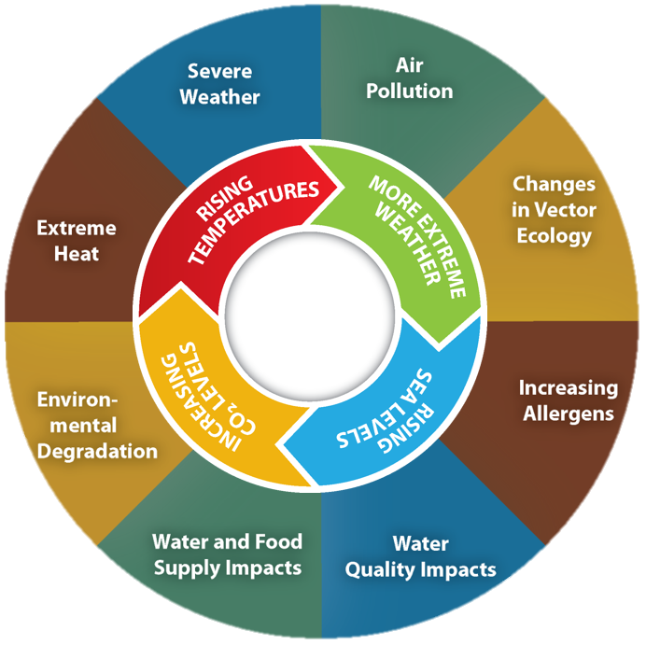
Understanding Climate Change
Average surface air temperature has increased 1.8°F over the last century.
Greenhouse gases like carbon dioxide trap heat.
Carbon dioxide is produced when oil or gas is burned.
Carbon dioxide levels are higher than they have been in more than 3 million years.
Climate change will have dramatic effects on human health.
Notes:
Background on Climate Change
Global annually averaged surface air temperature has increased by about 1.8°F (1.0°C) over the last century. Much of the blame lies with the emission of greenhouse gases, including carbon dioxide (CO₂). The gas concentration of CO₂ in the atmosphere has increased beyond 400 parts per million, a level that was last reached 3 million years ago. The magnitude of climate change beyond the next few decades will depend primarily on the amount of greenhouse gases emitted globally. The effects of climate change on human health are significant.

Slide 4

Think About It
Before you start this lesson, what are your initial thoughts on climate change?
What is the difference between weather and climate?
What has happened in the last 150 years to cause the climate to have higher average temperatures?

Slide 5
Climate, Health, and CDC
Effects of Climate Change on Health
Temperature Extremes: more heat-related deaths and medical visits for cardiovascular, kidney, & respiratory disorders
Floods: increased drowning deaths and higher exposures to mold and waterborne diseases
Wildfires: poor air quality increases respiratory and cardiovascular issues like asthma and COPD
Air Pollution: exposure to particulate matter and ozone increases hospitalizations and deaths for respiratory diseases like asthma
Allergens and Pollen: longer growing seasons mean more pollen and increased allergy rates
Notes:
Climate, Health, and the Centers for Disease Control and Prevention (CDC)
Climate change influences human health and disease in numerous ways. Because of climate change, some existing health threats will intensify, and other new health threats will emerge. Public health officials must look beyond just rising global temperatures to see the far-reaching effects of climate change on a community and its overall health.
Temperature Extremes: Extreme summer heat is increasing in the United States, and climate projections indicate that extreme heat events will be more frequent and intense in coming decades. Heat waves are associated with increased hospital admissions and deaths due to cardiovascular, kidney, and respiratory disorders. Urban heat islands, combined with an aging population and increased urbanization, are projected to increase the vulnerability of urban populations to heat-related health impacts in the future. The effects of milder winters will help to reduce harms associated with cold and snow, but that impact does not cancel out the effect of heat-related illnesses and deaths.
Related: CDC’s Heat and Health Tracker: https://ephtracking.cdc.gov/Applications/heatTracker
Floods: Increases in both extreme precipitation and total precipitation have contributed to increases in severe flooding events. Floods are the second deadliest of all weather-related hazards in the United States, accounting for approximately 98 deaths per year, mostly due to drowning. After extreme precipitation events, hazards like waterborne disease outbreaks and mold growth increase. Populations living in damp indoor environments experience higher rates of respiratory symptoms, asthma, and respiratory tract infections.
Wildfires: Long periods of record high temperatures are associated with droughts that contribute to dry conditions and drive wildfires in some areas. Wildfire smoke contains particulate matter, carbon monoxide, nitrogen oxides, and various volatile organic compounds and can significantly reduce air quality, both locally and in areas downwind of fires. Smoke exposure increases respiratory and cardiovascular hospitalizations and emergency room visits for asthma, bronchitis, chest pain, chronic obstructive pulmonary disease (COPD), and respiratory infections.
Air Pollution: Climate change is projected to harm human health by increasing ground-level ozone and/or particulate matter air pollution in some locations. Ground-level ozone is associated with many health problems, such as diminished lung function, increased hospital admissions and emergency room visits for asthma, and increases in premature deaths. Particulate matter concentrations are affected by wildfire emissions and episodes of air stagnation (caused by nonmoving air).
Allergens and Pollen: Climate change will potentially lead to both higher pollen concentrations and lon ger pollen seasons, causing more people to suffer more health effects from pollen and other allergens. Pollen exposure can trigger various allergic reactions, with symptoms like itchy eyes, runny nose, sneezing, cough, and congestion. Exposure to pollen has been linked to asthma attacks and increases in hospital admissions for respiratory illness.

Slide 6
Climate, Health, and CDC
Effects of Climate Change on Health
Food Security: changing climate and more severe weather leads to declining crop yields and less food produced; prices rise and more people go hungry
Disease Carried by Vectors: disease-carrying organisms like mosquitoes can move into new areas
Mental Heath and Stress-Related Disorders: higher rates of poor mental health following climate-related disaster events like floods, hurricanes, and wildfires
Food and Waterborne Diarrheal Diseases: higher rates of foodborne and waterborne illnesses due to higher temperatures and extreme rainfall events
Notes:
Food Security: Many crop yields are predicted to decline because of the combined effects of changes in rainfall, severe weather events, and increasing competition from weeds and pests on crop plants. Livestock and fish production are also projected to decline. Prices are expected to rise in response to declining food production and trends such as increasingly expensive petroleum. Food insecurity increases with rising food prices, resulting in hunger, malnutrition, or obesity as people turn to nutrient-poor processed foods.
Diseases Carried by Vectors: Climate is one of the factors that influences the distribution of diseases borne by vectors (such as fleas, ticks, and mosquitoes, which spread pathogens that cause illness). North Americans are currently at risk from numerous vector-borne diseases, including Lyme disease, dengue fever, West Nile virus disease, Rocky Mountain spotted fever, plague, and tularemia. Infectious disease transmission is sensitive to local, small-scale differences in weather, human modification of the landscape, the diversity of animal hosts, and human behavior that affects vector-human contact, among other factors.
Mental Health and Stress-Related Disorders: Following disasters, mental health problems increase, both among people with no history of mental illness, and those at risk. For example, research demonstrated high levels of anxiety and post-traumatic stress disorder among people affected by Hurricane Katrina, and similar observations have followed floods, heat waves, and possibly wildfires. Other health consequences of intensely stressful exposures are also a concern, including pre-term birth, low birth weight, and maternal complications.
Food and Waterborne Diarrheal Diseases: Exposure to a variety of pathogens in water and food causes diarrheal disease. Air and water temperatures, precipitation patterns, extreme rainfall events, and seasonal variations are all known to affect disease transmission. In general, diarrheal diseases, including salmonellosis and campylobacteriosis, are more common when temperatures are higher, though patterns differ by place and pathogen. Diarrheal diseases have also been found to occur more frequently in conjunction with both unusually high and low precipitation.

Slide 7
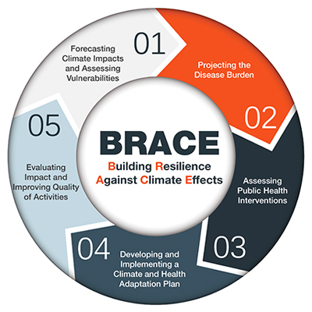
Climate, Health, and CDC
Building Resistance Against Climate Effects (BRACE)
Identify the severity of climate impacts and vulnerable populations.
Determine the effects of
climate change.
Design interventions for
the health impacts of greatest concern.
Distribute a written plan
for implementation.
Evaluate the effectiveness and edit plan.
Notes:
CDC is using its expertise to help state, tribal, local, and territorial health departments prepare for and respond to the health effects that a changing climate may bring to their communities. Likely impacts include increased extreme weather events, wildfires, decreased air quality, and illnesses transmitted by food, water, and disease carriers such as mosquitoes and ticks. CDC’s Climate-Ready States and Cities Initiative is helping grant recipients use the Building Resilience Against Climate Effects (BRACE https://www.cdc.gov/climate-health/php/brace/?CDC_AAref_Val=https://www.cdc.gov/climateandhealth/BRACE.htm) framework to develop and implement health adaptation plans and address gaps in public health functions and services. Using this framework, officials will:
Identify the severity of climate impacts, health outcomes, and the populations and locations vulnerable to health impacts.
Determine the effects of climate change on local health and the impact on health systems.
Design interventions for the health impacts of greatest concern.
Develop and distribute a written plan for implementation.
Evaluate the effectiveness of the interventions and edit plan.
Related: Climate and BRACE Videos: https://www.cdc.gov/climate-health/php/resources/videos.html?CDC_AAref_Val=https://www.cdc.gov/climateandhealth/videos.html
Health equity is an important factor when designing interventions for the effects of climate change. Vulnerable groups include those with low income, some communities of color, immigrant groups, indigenous peoples, children, pregnant women, older adults, and persons with disabilities. Any interventions should consider the needs of these communities, as they are more likely to face harm because of the changing climate.

Slide 8
Think About It
Which people around the world will be most vulnerable to the health effects of climate change? Why?
In your community, which of the nine health effects of climate change presented do you think will have the greatest impact?
CDC’s BRACE framework is designed to help cities prepare for climate change instead of just reacting to it. What are some barriers or challenges that might make this process difficult?

Slide 9
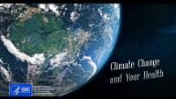
From the Expert
https://youtu.be/yUmwA-GjE1Q
Notes:
From the Expert:
CDC’s Climate and Health Program is celebrating its support of state, tribal, local, and territorial public health agencies as they prepare for the continuing health impacts of a changing climate. Take a tour of the Climate & Health: A Decade of Preparing Communities exhibition at the David J. Sencer CDC Museum. The exhibition includes photographs and dramatic maps to tell representative stories about the intersections of climate and health: ongoing heatwaves, California forest fires, and flooding in the Midwest. https://youtu.be/yUmwA-GjE1Q

Slide 10
Think About It
The exhibition at the CDC Museum focuses on extreme heat, wildfires, and floods. Why do you think these three topics were chosen?
Which health effect of climate change are you most interested in learning more about? Why does that topic interest you?
Do you think that environmental justice can be achieved in the United States? Explain your answer.

Slide 11
Give it a Try
Call to Action!
Measure the effects of a greenhouse gas.
Research a health effect of climate change.
Share your findings.
Why do you think participation is important?
Notes:
Call to Action
In order to understand how climate change affects health it is essential that people understand how climate change occurs and what we can do to protect vulnerable groups from its effects. You can help people by following these three steps:
Measure the effects of a greenhouse gas. You will start by asking, “How does the presence of carbon dioxide affect atmospheric temperature?” by using bottles filled with air or CO₂ to see how temperature varies when the bottles are exposed to bright light.
Research a health effect of climate change. This lesson gives brief background information on some of the public health effects of climate change. Choose one to research and present your findings in an infographic.
Share your findings. One of the ways CDC communicates information is through social media. Your demonstrations can help CDC communicate the work they have done and are doing to reduce the effects of climate change on public health.

Slide 12
Use the Scientific Method
Ask
Ask a question
Research
Do background research
Hypothesis
Construct hypothesis
Test
Test with an experiment
Analyze
Analyze data
Draw conclusions
Conclusions
Share
Communicate results

Slide 13
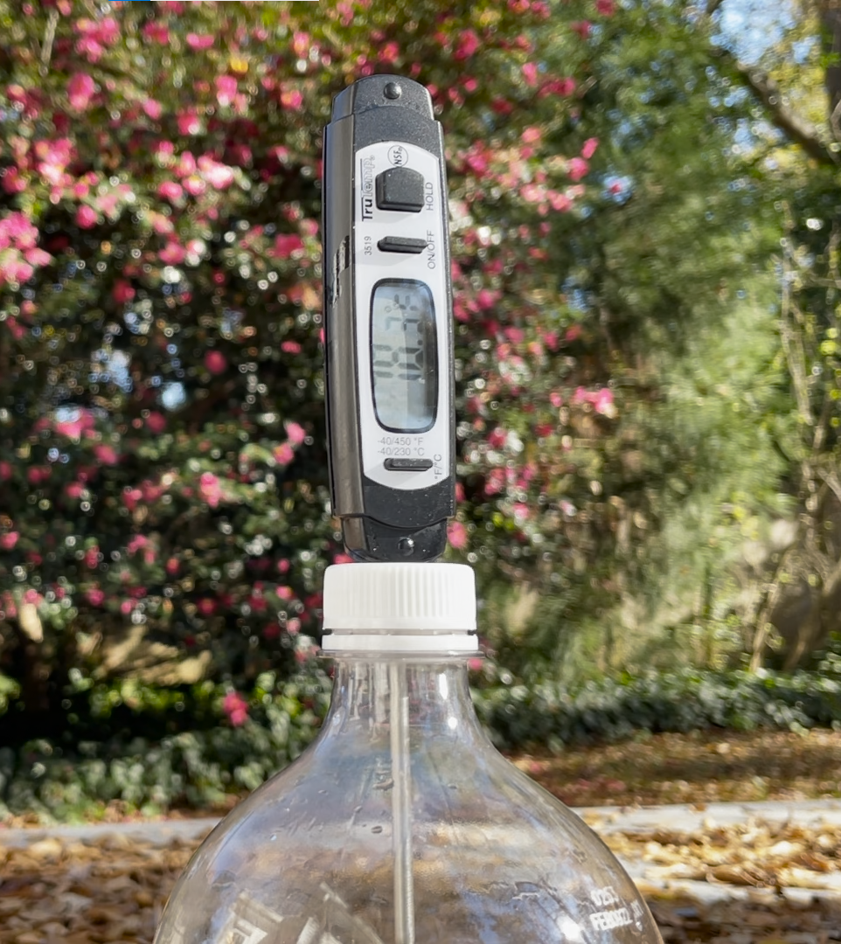

Give it a Try
1. Measure the Effects of a Greenhouse Gas
Set up two plastic bottles with different atmospheres: one with normal air and the other with more carbon dioxide
Expose both bottles to bright light and measure the temperature every 20 seconds
Share your findings by creating a scientific research poster to share with others
Notes:
The production of greenhouse gases like carbon dioxide is the main driver of climate change. For this experiment, you will be testing to see how different gases affect the temperature inside a bottle that is exposed to bright light. You will be testing two atmospheres: one made of the normal air we breathe and another with a higher percentage of carbon dioxide.
Materials
2 large identical clear juice, soda, or water bottles (64 oz juice, 2 L soda, or 1 gal water work)
2 thermometers
4 teaspoons baking soda
1 cup vinegar
Bright sunshine or a 100W or brighter incandescent light bulb and lamp
(Fluorescent and LED light bulbs are great for the planet, but not for this experiment.)
Timer/stopwatch
First, decide how you are going to measure the temperature of your bottle. A digital thermometer designed for science or food use works best. The thermometer must have a wide enough range to measure air temperatures. Drop the thermometer in or poke a hole in the bottle or cap in which to stick your thermometer probe. If you only have one thermometer or bottle, you can test the two different setups back-to-back instead of simultaneously. Using this latter approach may impact the consistency of the experiment and the results.
Bottle 1: Normal atmosphere
Add 1 cup of water to the bottle and put on the bottle cap. This is a control to help keep the conditions similar in both bottles. Both bottles will have 1 cup of liquid in the bottom.
Bottle 2: High carbon dioxide
Filling the second bottle with carbon dioxide by reacting baking soda and vinegar.
CAUTION: Carbon dioxide is denser than air is, so it tends to sink and can be tricky to get out. If you put CO₂ in your bottle and want to do a normal air trial later using the same bottle, fill the bottle to the top with water and then dump it out to ensure that all the CO₂ is gone.
This next step can be messy, so consider completing this outside or in a sink should it overflow. Add 4 teaspoons (~12 g) of baking soda to your bottle. Pour in 1 cup of vinegar (~250 ml). This will react to produce vigorous bubbling. Swirl gently to mix. Once the bubbling has slowed down (after ~30 seconds), place the cap on the bottle. Too much pressure in the bottle may cause it to burst, so let the vigorous bubbling stop before capping. Fun fact: this reaction is endothermic, so if you feel the bottom, it should be cool to the touch.
Record Temperature Data
Insert your thermometers. Record your bottles’ initial temperatures. Expose them to your chosen light source – either bright, direct sunlight or a 100W or brighter incandescent light bulb – and immediately start a timer. Record the temperature of both bottles every 20 seconds until they no longer change. The data table goes to 10 minutes, but once you’ve gotten three consistent temperatures in a row for both bottles, you can stop the experiment early. Optional: Consider repeating this experiment more than once. Multiple trials can add reliability to your data.
Make a Scientific Research Poster
Once you are done with your experiment, you need to present your findings to others. One way that scientists communicate information is through posters, usually at conferences or poster sessions designed for people to share their current research findings. These posters are large - usually around 4 ft x 5 ft. The poster template on the next page is a simplified version of what you might put on a poster after conducting original research.
If you prefer to make a digital poster, most are made as presentation slides using programs like Microsoft PowerPoint or Google Slides.
Title/Author: Include a descriptive title that draws the reader in. Also include your name and school or program along with any supervisors who helped you.
Introduction: Explain any background information that the reader needs to be able to understand your findings. You might need to do a little more research on the topic to be able to explain what greenhouse gases are and how they are produced.
Methods: Describe the procedure you are performing, including your experimental setup and how you are collecting your data. Make sure to explain what equipment you are using. Be as specific as possible so that someone reading your poster could perform this experiment on their own.
Results: What happened in your experiment? Include a summary of your data. This is section where you focus on WHAT patterns your data show, not WHY your data shows patterns. You collected numerical data, so make sure your results section includes your specific numbers rather than general phrases like “went up” or “decreased” when describing observed patterns. Your graph is also part of this section. Make sure it has a title, labels for both axes that include the units of measurement used, and a key to distinguish your two data sets.
Conclusions: What does your data mean? How do your results answer your research question? This is where you move from the WHAT happened into the WHY it happened. You can start to draw conclusions here about explanations for the patterns you see in the data.

Slide 14
Give it a Try
2. Research a Health Effect of Climate Change
Choose one of the health effects of climate change to research
  Air pollution
  Allergens and pollen
  Diseases carried by vectors
  Food and waterborne diseases
  Food security
  Mental health and stress-related disorders
  Floods
  Temperature extremes
  Wildfires
Build an infographic to present your research
Notes:
Research a Health Effect of Climate Change
Now that you have explored the causes of climate change, let’s shift to talking about its effects on public health. In the introduction, we briefly discussed nine different categories of public health issues that are connected to climate change.
Air pollution
Allergens and pollen
Diseases carried by vectors
Food and waterborne diseases
Food security
Mental health and stress-related disorders
Floods
Temperature extremes
Wildfires
For this second activity, you will choose one of them to explore further. Choose one of the nine topics listed and research using CDC’s website (https://www.cdc.gov) or other credible sites such as those ending in .gov, ones connected to universities, or trustworthy nonprofits. You will likely find a lot of information, but you must remember to focus specifically on the effects of climate change, not just the general topic. As you are researching, consider the following questions:
What are some effects that climate change affects your chosen health topic?
What populations are most likely to face harms related to this topic due to climate change?
How can we protect people, particularly those most vulnerable, from the health effects of climate change related to this topic?
Build an Infographic
Put your findings together by creating an infographic like the one in the main lesson document or student instruction sheet.
There are several great digital tools that can help you make excellent images. Try looking up “free infographic maker” online and explore a new tool!

Slide 15
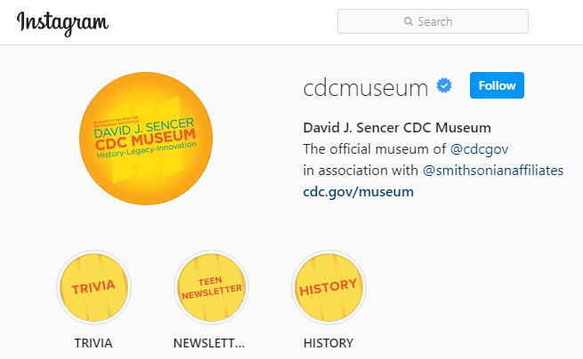
Give it a Try
3. Share Your Findings
Instagram @CDCmuseum
Notes:
Share Your Findings
For the full scientific research experience, conduct your very own poster session by explaining your poster and your infographic to family or friends. By explaining your findings to others, you deepen your own understanding and develop better communication skills.
Post your infographic on social media or share through email with others in your community. You can even ask your science teacher if you can display a copy in their classroom. You can share your research poster and infographic with the CDC Museum on Instagram using @CDCmuseum. The David J. Sencer CDC Museum uses award-winning exhibits and innovative programming to educate visitors about the value of public health and presents the rich heritage and vast accomplishments of CDC. Your experiments and infographic could be a valuable contribution!

Slide 16

Questions?

