Slide 1

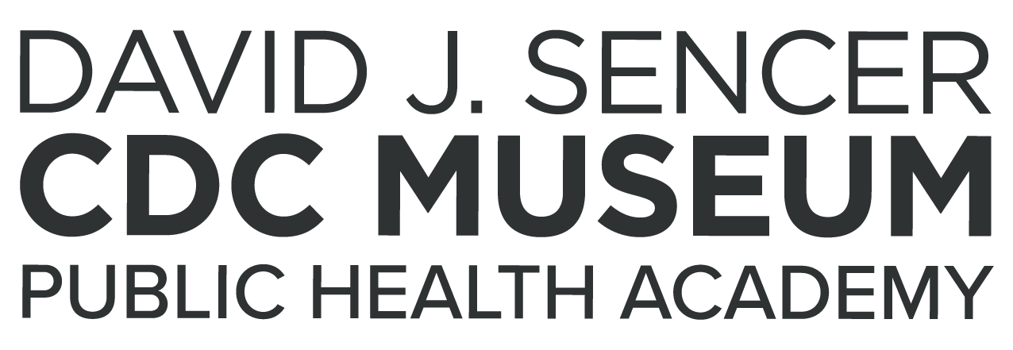
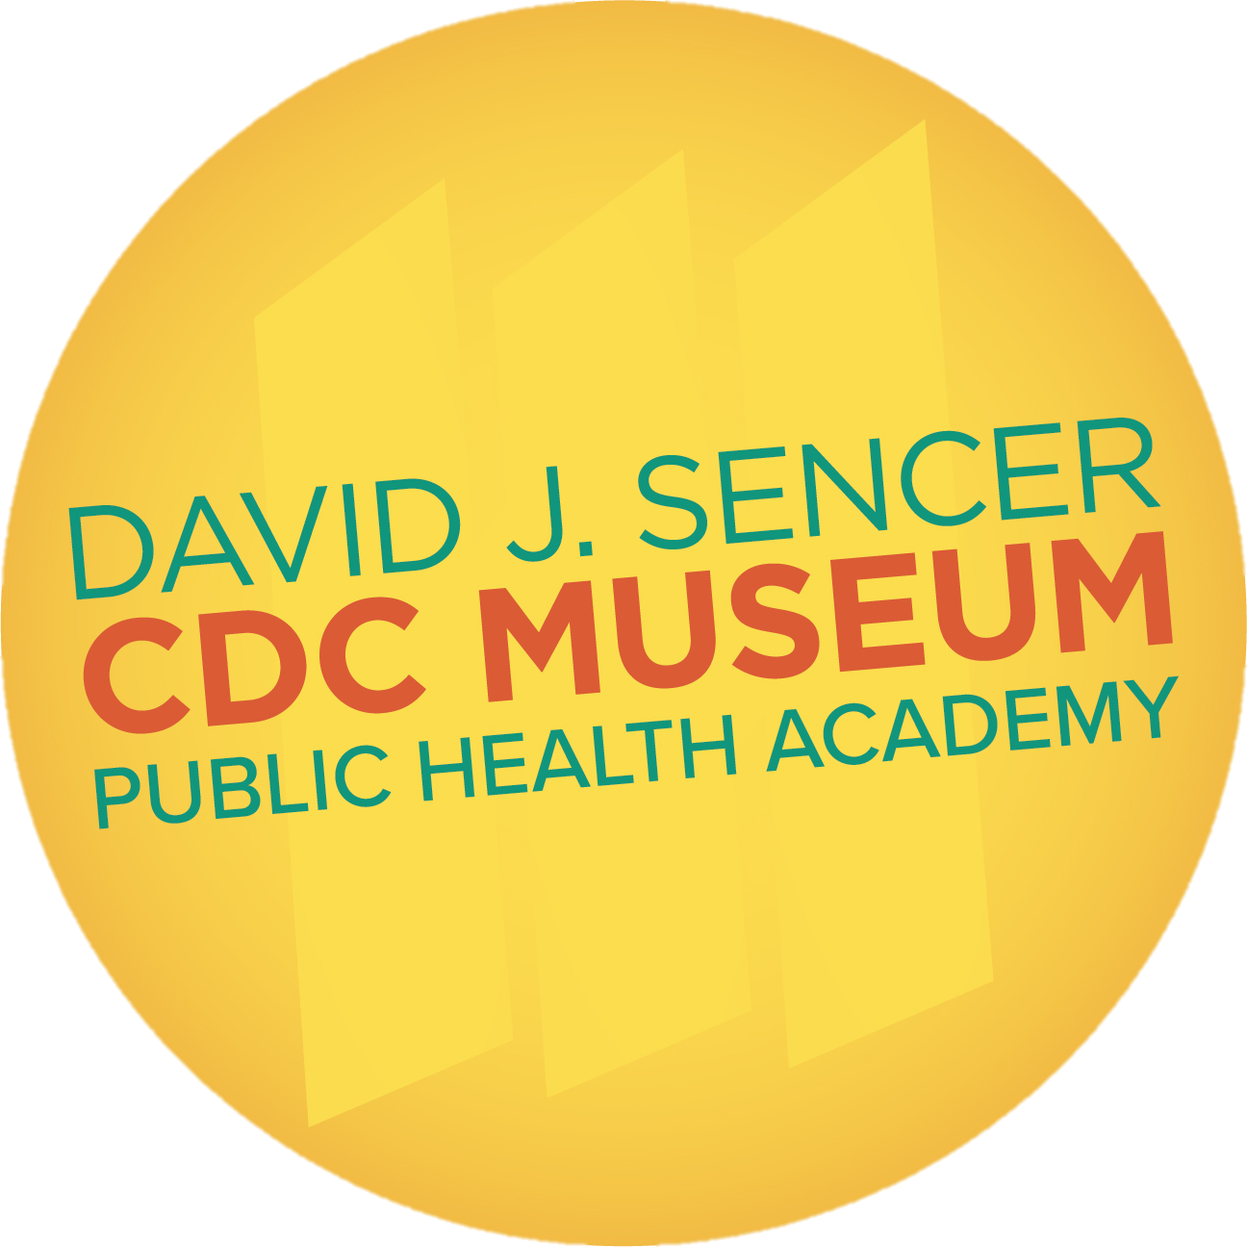
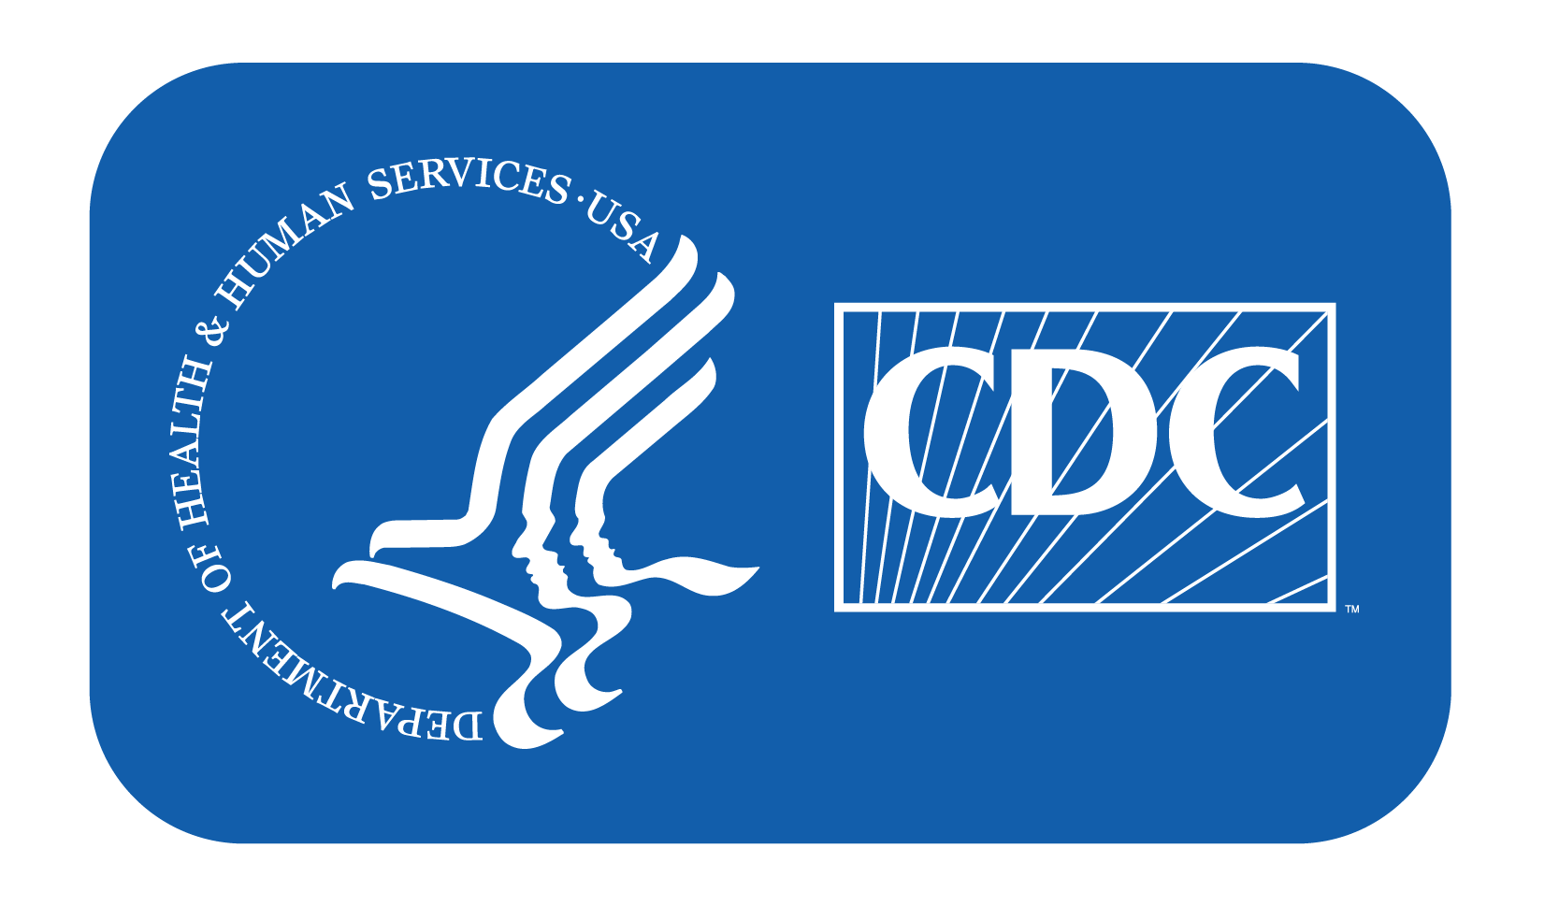
Preparing for Disasters
Notes:
The Centers for Disease Control and Prevention (CDC) provides emergency preparedness resources for local and state health departments and dispatch experts to help when disasters strike. When natural disasters, diseases, accidents, or terrorism occurs, CDC responds to help improve the health of those affected, both at home and abroad.
Note: These slides are made possible by the David J. Sencer CDC Museum Public Health Academy. https://www.cdc.gov/museum/education/lessons/

Slide 2
 | study of the distribution and control of health-related issues, including diseases
 | leaving an area to escape a potential disaster
 | the science of protecting and improving the health of people and their communities
 | the use of biological agents for the purpose of terrorism (ex: anthrax, smallpox)
 | an increase in the number of cases of a disease above what is normally expected in an area
 | an odorless, colorless gas that is produced any time a fossil fuel is burned
Word Bank
Bioterrorism
Carbon monoxide
Epidemiology
Evacuation
Outbreak
Public Health
Notes:
Terms to Know
Bioterrorism - the use of biological agents for the purpose of terrorism (ex: anthrax, smallpox)
Carbon monoxide - an odorless, colorless gas that is produced any time a fossil fuel is burned; can cause sudden illness and death; its chemical formula is CO
Epidemiology - study of the distribution and control of health-related issues, including diseases
Evacuation - leaving an area to escape a potential disaster
Outbreak - an increase in the number of cases of a disease above what is normally expected in that population in that area
Public Health - the science of protecting and improving the health of people and their communities

Slide 3
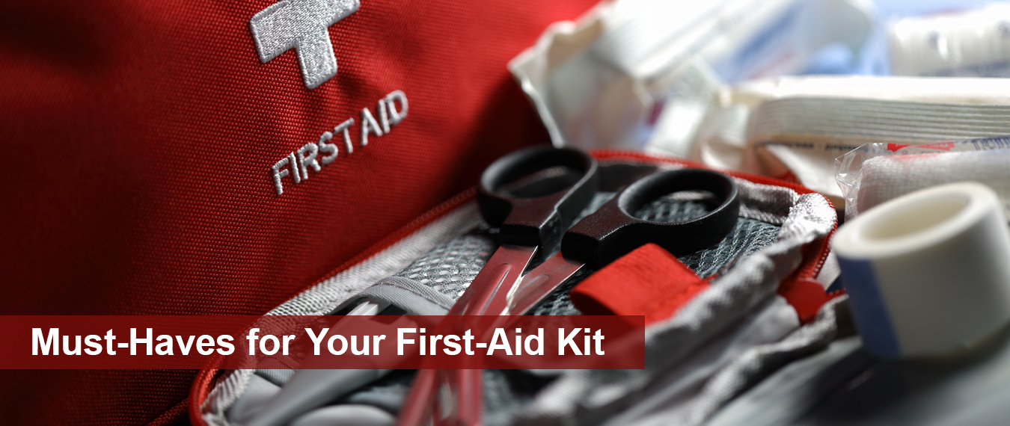
Understanding Disaster Planning
Preparing for different types of disasters and emergencies before they happen is critically important
2019 National Household Survey conducted by the Federal Emergency Management Agency (FEMA)
  80% have enough food and water to last 3+ days
  48% have an emergency action plan
Notes:
Planning for Emergencies
Planning for how to maintain and protect your health in a disaster or emergency is an important but often overlooked part of the preparedness process. While 80 percent of respondents to FEMA’s 2019 National Household Survey said they had gathered enough supplies to last three or more days, just 48 percent said they had an emergency action plan. Involve your entire family in planning and practicing how to stay healthy, informed, calm, and connected during an emergency.

Slide 4

Think About It
What kinds of natural or human-made disasters could happen in your area?
Have you ever experienced a disaster? What helped you stay healthy and survive? If you haven’t experienced a disaster, what do you think would be helpful?
What diseases could cause a widespread public health emergency?

Slide 5
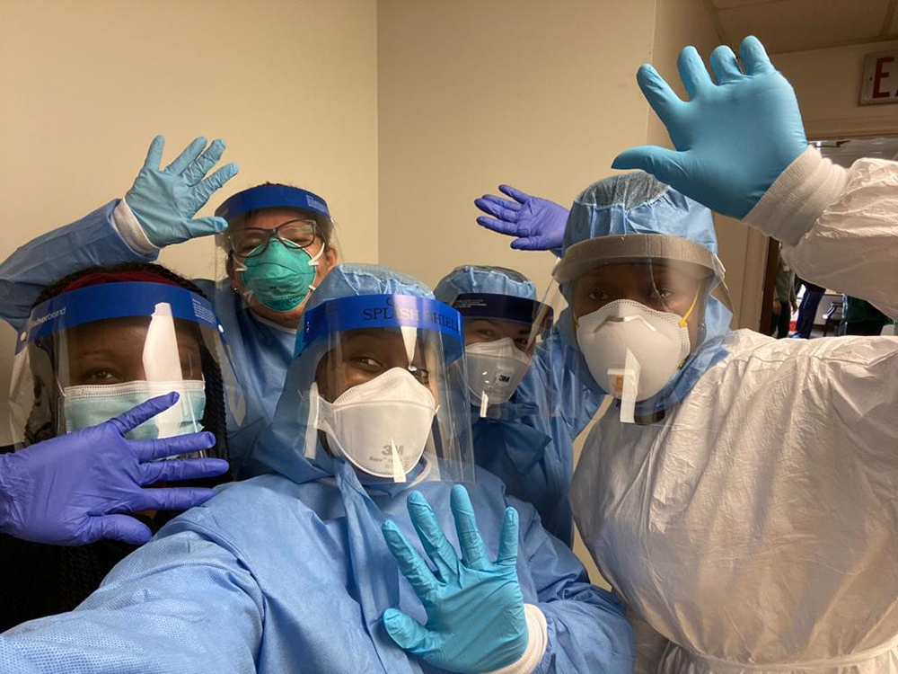
Disaster Planning and CDC
CDC provides training programs,
resources, and guidance to state,
local, and international health
departments to aid with disaster
response
CDC activates the Emergency Operations Center (EOC) to respond to immediate public health threats
CDC’s Office of Readiness and Response (ORR) coordinates preparation, response, and recovery from major disasters
CDC sometimes provides personnel who can deploy at a moment’s notice to respond to health emergencies worldwide
Notes:
Emergencies and the Centers for Disease Control and Prevention (CDC)
The Office of Readiness and Response (ORR) is the branch of CDC responsible for coordinating personal health preparedness for public health emergencies. ORR helps communities prepare, respond, and recover from emergency situations like disease outbreaks, natural disasters, industrial accidents, and bioterrorism that threaten people’s wellbeing.
In the United States, ORR offers a variety of resources for communities to help them prepare and respond to a health emergency. The Public Health Emergency Preparedness (PHEP) cooperative agreement provides funding for health departments to help them build and strengthen their abilities to respond to public health threats. CDC also has a framework to help local health departments plan and train for disasters. PHEP funds are even used for special events, such as preparing security plans, training first responders, tracking illnesses, and monitoring food safety for the 2019 Super Bowl in Atlanta. The agreement also funds The Division of State and Local Readiness (DSLR) who are deployed to the field to help with emergency preparedness and response operations.
Globally, CDC maintains a team of people who can deploy at a moment’s notice to help manage public health emergencies. Between October 2015 and December 2020, a group of 554 team members spent a total of more than 61,000 days in the field. These teams provide long term staffing, train the emergency workforce, and coordinate local and global organizational response.

Slide 6
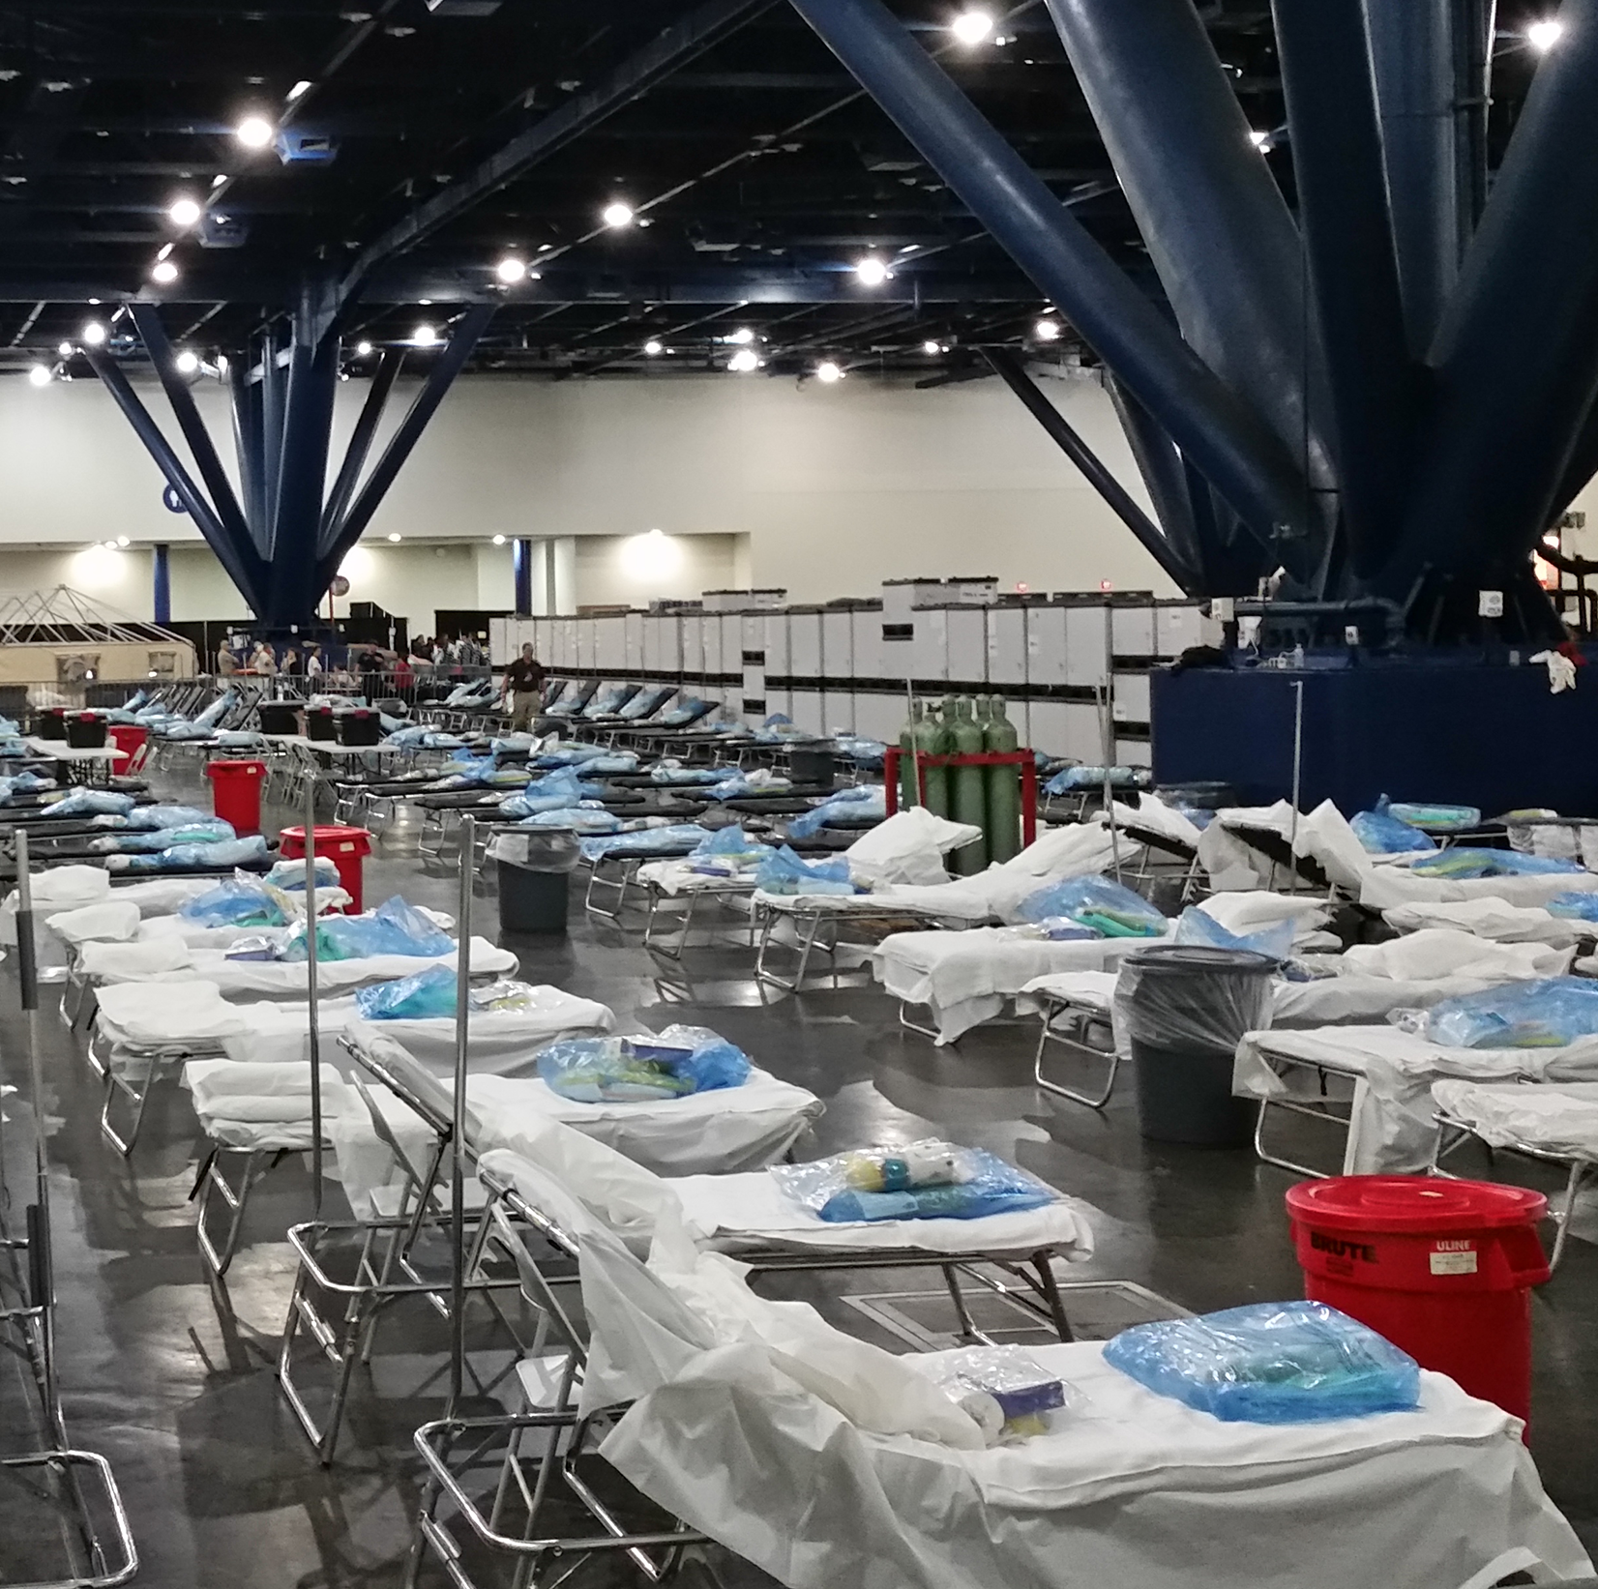
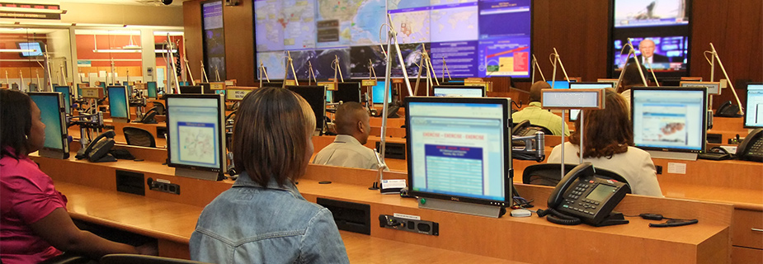
Disaster Planning and CDC
What types of emergencies does CDC respond to?
  Natural disasters like storms, tornadoes, flooding, earthquakes, wildfires, hurricanes, landslides, mudslides, extreme heat, and winter weather
  Human-made disasters such as chemical releases, radiation emergencies, and terrorism
  Disease outbreaks such as tuberculosis, Ebola, Legionnaire’s disease, hepatitis, Salmonella, cholera, COVID-19, influenza, E. coli, measles
Notes:
Disease
CDC responds to emerging disease outbreaks to protect public health on the local and global stages. During an outbreak, CDC makes recommendations to the public for measures they can take to protect themselves from disease, such as wearing masks and social distancing during the COVID-19 pandemic. When most people think of CDC, they think of diseases like flu and COVID-19. However, the list of monitored diseases is much longer and includes a range of conditions such as hepatitis A, measles, tuberculosis, and cholera. It also includes foodborne illnesses such as those caused by E. coli, Salmonella, and Shigella, which are all closely monitored in cooperation with the Food and Drug Administration. CDC responds to outbreaks at the global level, include notable ones, such as the 2014 Ebola outbreak in West Africa and the 2009 H1N1 influenza pandemic. CDC maintains a list of current outbreaks: https://www.cdc.gov/outbreaks/index.html
Natural Disasters
Thunderstorms, tornadoes, and flooding pose a variety of dangers. Flying and falling objects can cause injury or death. As little as six inches of moving water can cause a vehicle to lose control. Lightning is one of the leading causes of weather-related fatalities, averaging about 27 fatalities a year between 2010-2020. Earthquakes pose a threat in certain parts of the world, causing structural damage, falling objects, and subsequent fires. They can also trigger tsunamis in coastal regions that carry risks of drowning or traumatic injuries from colliding with objects after being swept up by the waves. Landslides and mudslides following heavy rains, drought, or earthquakes can quickly lead to danger. Wildfires increasingly threaten homes as people build homes in wildfire areas. Tracking fire spread, protecting yourself from smoke inhalation, and evacuating when necessary are important for safety. Winter weather carries risks for hypothermia and frostbite, particularly during power outages when heating systems aren’t functional. The opposite, excessive heat, can be just as lethal, causing heat stroke or heat exhaustion. Because natural disasters often arise quickly, it is important to have a plan in place beforehand that includes supplies, shelter or evacuation, and ways to reconnect with family.
It is critically important that you have a plan and supplies for the aftermath of a disaster. The risk of injuries doesn’t subside after a disaster, as fallen debris causes significant hazards. Injuries can also be difficult to get treatment for due to transportation difficulties or overwhelmed medical systems.
Unsanitary conditions after a storm can last weeks or months. Access to clean drinking water and safe food sources can be scarce, contributing to outbreaks of foodborne and diarrheal diseases. Disasters bring people in contact with dangerous insects and animals such as mosquitoes, rodents, snakes, and aggressive dogs. Long-term power outages result in increased cases of carbon monoxide poisoning due to misplaced generators or unsafe cooking practices. The mental health effects of stress, anxiety, and grief after a disaster should also be considered, particularly in people who were already suffering from mental health conditions.
Human-made Disasters
CDC also responds to human-made emergencies such as chemical releases, radiation emergencies, and acts of terrorism. Chemical spills can occur because of industrial accidents or through intentional release. In 1978, then-President Jimmy Carter declared a federal emergency when widespread chemical contamination was observed in the Love Canal neighborhood in Niagara Falls, NY. CDC provided physical examination of all residents of the former chemical dump and coordinated the federal response. This incident also led to the founding of the Agency for Toxic Substances and Disease Registry (ASTDR) that is now in charge of investigating the human effects of toxin exposure. CDC also has branches that help protect workers. After the 2010 Deepwater Horizon oil spill, investigators from the National Institute for Occupational Safety and Health (NIOSH) conducted a full health hazard investigation to protect workers from the oil rig.
Radiation emergencies include the intentional use of nuclear weapons, dirty bombs, or radiological exposure devices, as well as accidents from nuclear power plants, transportation, and manufacturing. In 1979, a nuclear power plant accident occurred at Three Mile Island Unit 2 in Middleton, Pennsylvania. CDC, along with many others, responded to evaluate the radiation exposure risks of all residents within 5 miles of the reactor. When a 2011 earthquake damaged a nuclear power plant in Fukushima, Japan, CDC and the Food and Drug Administration monitored the presence of radionucleotides in the environment and in food sources originating from Japan.
CDC also responds to acts of terrorism, including bioterrorism. NIOSH administers the World Trade Center Health Program, providing services to survivors and first responders affected by the 9/11 attacks in 2001. When deadly anthrax spores were mailed to many recipients in 2001, CDC investigated the 22 cases and 5 resulting deaths. CDC also maintains emergency response plans for various terrorist scenarios and activates its Emergency Operations Center when responding to attacks. Drills conducted by hospitals in Boston helped hospital workers prepare for the mass casualties that arrived after more than 260 were injured in the 2013 Boston marathon bombing.

Slide 7
Think About It
What are two things you found surprising in this reading?
Why do outbreaks of infectious diseases commonly occur after a natural disaster?
What are two ways that CDC works with local and state health departments to help communities prepare for disaster?

Slide 8

From the Experts
https://youtu.be/RwtEp84tGYQ
Notes:
From the Experts:
An Emergency Operations Center (EOC) is a centralized location that makes handling a disaster more efficient and effective. EOCs use systems to coordinate the people and things needed to mitigate a disaster. Watch this video to learn more about how EOCs, both small and large, act quickly in the face of a disaster. https://youtu.be/RwtEp84tGYQ
CDC activated its EOC in 2014 to respond to an Ebola outbreak in West Africa. Watch the video below to learn more about how it was used to stop the spread and help other countries manage their own health care resources to stop future outbreaks. https://www.youtube.com/watch?v=XDnyqgapbZM
Why Participate? A Message from CDC
We live in a time where information and communication are both available at the touch of a button. During emergencies, power outages and telecommunication interruptions are very common. What would you do if you couldn’t look up important survival information or contact your loved ones during an actual emergency? To avoid this situation, it is important to prepare before disaster strikes. By getting your family’s plan together and practicing your emergency routines, you can ensure your health and safety.

Slide 9
Think About It
If you woke up to a fire and could save only 3 things, what would you grab? Why?
What do your 3 things tell you about your priorities in an emergency? How can you use this information to help you plan for future disasters?
How do you respond in an emergency: cool and calm or panicked and anxious? How will you incorporate your typical reaction style into your disaster plan?

Slide 10
Give it a Try
Call to Action!
Develop a disaster plan.
Build a disaster kit.
Share your findings.
Why do you think participation is important?

Slide 11
Use the Engineering Design Process
Define
Define the problem
Research
Do background research
Requirements
Specify requirements
Brainstorm
Develop solutions
Build
Build a prototype
Test and redesign
Test
Share
Communicate results

Slide 12

Give it a Try
1. Develop a Disaster Plan
Research what kinds of disasters or emergencies might occur in your area
Develop evacuation or shelter-in-place plans for the disasters identified
Make copies of your plan and practice with other members of your household
Notes:
Develop a Disaster Plan
On January 13, 2018, a missile alert was issued through the Emergency Alert System to all cellphones in Hawaii. The message read: “Emergency Alert BALLISTIC MISSILE THREAT INBOUND TO HAWAII. SEEK IMMEDIATE SHELTER. THIS IS NOT A DRILL.” Similar messages were also played on all televisions and radio stations in the state. People were unsure of what to do, so panic ensued as people tried to seek shelter. If you received this alert, what would you do?
In this case, the alert was a false alarm sent mistakenly by an employee who was later fired from his position. What if it had been real, though? Would you know what to do?
When emergencies happen, having a plan that is already in place dramatically increases your chances of survival and improves outcomes. This activity is designed to get you thinking about the types of emergencies you may face and how you would respond.
For What Types of Emergencies Should I Prepare?
The first step of emergency planning is to determine the types of emergencies for which you need to prepare. Someone who lives in Oklahoma doesn’t need to prepare for hurricanes but does need to prepare for tornadoes. Do you live in an area that is prone to flooding? Is there a chemical plant or nuclear power plant within 5 miles of your house? Do you live in a wooded area that is subject to wildfires? Are you near an area that experiences earthquakes? CDC has information to help you prepare for these emergencies and more here: https://emergency.cdc.gov/hazards-specific.asp You may also want to check out the resources available from Ready.gov, a government-run site designed to help you prepare for all types of emergencies: https://www.ready.gov/
Make sure to consider the likelihood of the following emergency situations:
Avalanches
Bioterrorism
Chemical emergencies
Disease outbreaks
Earthquakes
Extreme heat
Floods
Gas leaks/explosions
House fires
Hurricanes
Landslides/mudslides
Lightning
Radiation emergencies
Tornadoes
Tsunamis
Volcanoes
Wildfires
Winter weather
How Do I Develop a Plan?
Once you’ve identified the types of emergencies for which you need to plan, it’s time to start putting together the details. This process can seem very overwhelming at first, but you can break it down by starting small. For most disasters, you will either need to shelter in place or evacuate to safety. You just need to figure out the details of how that’s going to work in different scenarios. You also need to think about important names and phone numbers of people you may need to contact, such as doctors or veterinarians, as well as policy numbers for insurance, and banking information to access accounts. Remember, you might not have access to online information after a disaster.
Here are a few questions for you to discuss with other members of your household:
How will you receive emergency alerts and warnings?
What is your shelter plan?
What is your evacuation plan?
What is your household’s communication plan?
Go to https://www.ready.gov/plan for more details and resources related to each of these questions. This site even has printable plans that you can fill out together.
As you develop your plan, make sure to consider the following factors to better match the plan to your household’s needs:
Different ages of members within your household
Responsibilities for assisting others
Locations frequented
Dietary needs
Medical needs, including prescriptions and equipment
Disabilities or access and functional needs, including devices and equipment
Languages spoken
Cultural and religious considerations
Pets or service animals
Households with school-aged children
What Do I Do With My Plan?
Once you have written down your emergency plan, make sure you have access to it. Keep copies in places where you may need access: home, work, school, and vehicles. Keep a secure digital copy as a backup, but don’t rely on it solely in case of power outages. Make sure that all family members, even children, know how to access the plan in case the family is separated.
Once the plan is written, practice it! The first time you do something, there’s always room for improvement. Work with your household to rehearse the plan, making sure that each person knows their role in the plan. This can be tricky or even scary for younger children, so make sure to check out the resources available at https://www.ready.gov/kids to make the process easier.

Slide 13
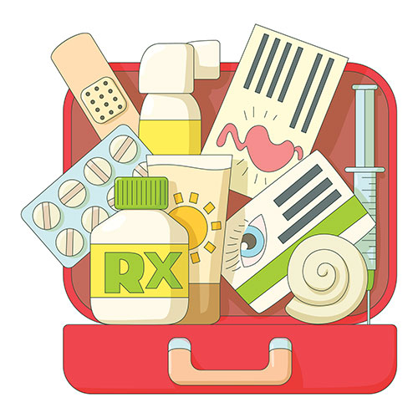
Give it a Try
2. Build a Disaster Kit
Gather necessary supplies to build an emergency kit with supplies for your household
Pack your kit into an appropriate container and store where needed
Notes:
Build a Disaster Kit
Now that you have an idea of what to do, it’s time to think about what you’ll need. For natural disasters like hurricanes, you may go for weeks without power or access to fresh food and water. After Hurricane Maria hit Puerto Rico, it took 11 months to restore power to all areas! For disasters like wildfires or landslides, it is possible that you will temporarily move into an emergency shelter only to return to a home that is no longer there. It is important to be ready to survive whatever comes your way. In this activity, you will gather the resources needed and create an emergency disaster survival kit.
Basic Supply List
Water (one gallon per person per day for several days, for drinking and sanitation)
Food (at least a three-day supply of non-perishable food)
Battery-powered or hand crank radio and a NOAA Weather Radio with tone alert
Flashlight
First aid kit
Extra batteries
Whistle (to signal for help)
Dust mask (to help filter contaminated air)
Plastic sheeting and duct tape (to shelter in place)
Moist towelettes, garbage bags and plastic ties (for personal sanitation)
Wrench or pliers (to turn off utilities)
Manual can opener (for food)
Local maps
Cell phone with chargers and a backup battery
Additional Supplies You May Need
COVID-19 supplies - masks for everyone aged 2 and above, soap, hand sanitizer, disinfecting wipes for surfaces
Prescription medications
Non-prescription medications such as pain relievers, anti-diarrhea medication, antacids, or laxatives
Prescription eyeglasses and contact lens solution
Infant formula, bottles, diapers, wipes, and diaper rash cream
Pet food and extra water for your pet
Cash or traveler’s checks
Important family documents, such as copies of insurance policies, identification and bank account records saved electronically or in a waterproof, portable container
Sleeping bag or warm blanket for each person
Complete change of clothing appropriate for your climate and sturdy shoes
Fire extinguisher
Matches in a waterproof container
Feminine supplies and personal hygiene items
Mess kits, paper cups, plates, paper towels and plastic utensils
Paper and pencil
Books, games, puzzles, or other activities for children
Pack Your Kit
This kit can be used for sheltering in place or evacuation, so it is important that it be semi-portable. A large plastic storage bin is a good choice for weatherproofing supplies. You might also use or include smaller bags or backpacks to make carrying the supplies easier in case of evacuation. Consider making more than one kit so that you have access to emergency supplies no matter where you are (home, car, work). Include a printed copy of your disaster plan in all kits. Be careful about storing too much personal information in your car due to the potential for break-ins and risk of identity theft.

Slide 14
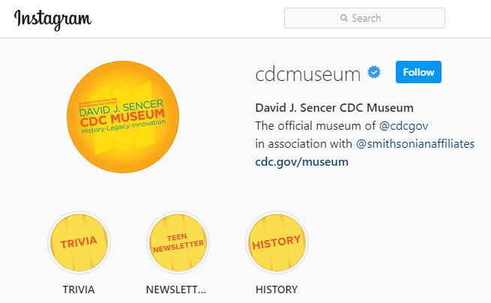
Give it a Try
3. Share Your Findings
Instagram @CDCmuseum
Notes:
Share Your Findings
The David J. Sencer CDC Museum uses award-winning exhibits and innovative programming to educate visitors about the value of public health and presents the rich heritage and vast accomplishments of CDC. Your plan could be a valuable contribution! Share your demonstration with the CDC Museum on Instagram using @CDCmuseum.

Slide 15
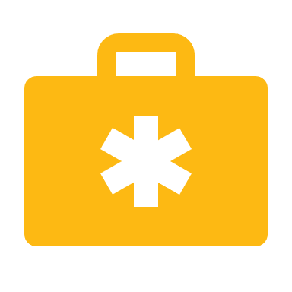
Questions?

