Slide 1


Data linkage methodologies to study alcohol-related mortality
ICE on Injury Statistics September 29th. 2012
Gordon Smith MB.ChB., M.P.H.
National Study Center for Trauma & EMS
Shock Trauma Center and
Department of Epidemiology and Public Health
University of Maryland, Baltimore

Slide 2
Outline
Aim to illustrate the value of data linkage in injury studies and informing clinical practice
Injury cohort study alcohol and trauma outcome and mortality
  Background trauma recidivism
  Data sources
  Previous preliminary study
    Methods and results
Stimulate discussion of data linkage in the ICE

Slide 3

Hazards of alcohol and acute injury risk well known
Don't Mix and Drive, WPA poster ca. 1937

Slide 4
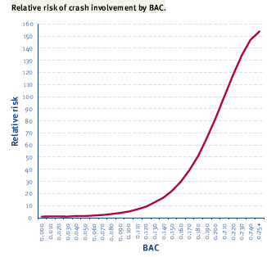
Adapted: Compton, R.P., Blomberg, R.D.,Moskowitz, H., Burns, M., Peck, R.C. & Fiorentino, D. (2002) Crash rate of alcohol impaired driving. Proceedings 16th International Conference on Alcohol, Drugs and Traffic Safety (ICADTS), Montreal

Slide 5


Slide 6
What do we know about the long term effects of alcohol
Belinda Gabbe followed up trauma patients to see how they recover
  Expensive active follow-up even with efficient methods such as in Victoria?
Can we passively follow-up these patients using data linkage to evaluate outcomes?
  If discharged alive from a trauma center do the patients die of another injury?

Slide 7
Background
26-52% of men and 14-24% of women admitted to trauma centers test positive for alcohol at the time of admission
25%-50% of trauma patients have a diagnosis (DSM-III-R) of alcohol abuse or dependence at the time of admission
Up to 50% of trauma patients test positive for another drug of abuse

Slide 8
Recidivism
Patients with alcohol use problems are more likely to sustain repeat injuries:
  Kaufman et al. (‘98) and Sims et al. (‘89) found higher rates of substance abuse among patients with two or more admissions to the same hospital
  Rivara et al. (‘93) reported that patients testing positive for alcohol had a 2.5X greater risk of readmission to the same hospital for injury
Are they more likely to die of another injury and can we predict those at risk for dying of another injury?
  Use of data linkage to evaluate this in Maryland

Slide 9
Available Injury Data Sources
Pre-Hospital
  Police Crash Reports
  EMS Runsheets
Hospital
  Emergency Dept. Data
  Hospital Discharge Data
  Trauma Registry Data
  Toxicology Data
Medical Examiner Data

Slide 10
Available Injury Data Sources in Maryland
Police Crash
Reports
Ambulance
& EMS Logs
Driver Citations
MVA Licensing
ED Data
Hospital
Records
Vital
Statistics
Autopsy
Records
Statewide
Trauma Registry
Toxicology

Slide 11

Our center (NSC) has long history data linkage for traffic records
CODES
  Strong relationships built with state agencies
  Unique capacity for data linkage
  Greatly expands information available
    Police crash reports
    Department Motor Vehicle Administration
      License files including convictions
      Medical Advisory Board
Comprehensive statewide medical examiner system
Shock Trauma
  Alcohol testing standard of care
  Urine drug screening
Earlier study linked trauma center data with death certificates

Slide 12
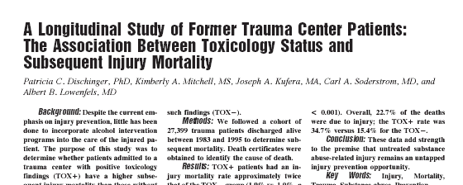
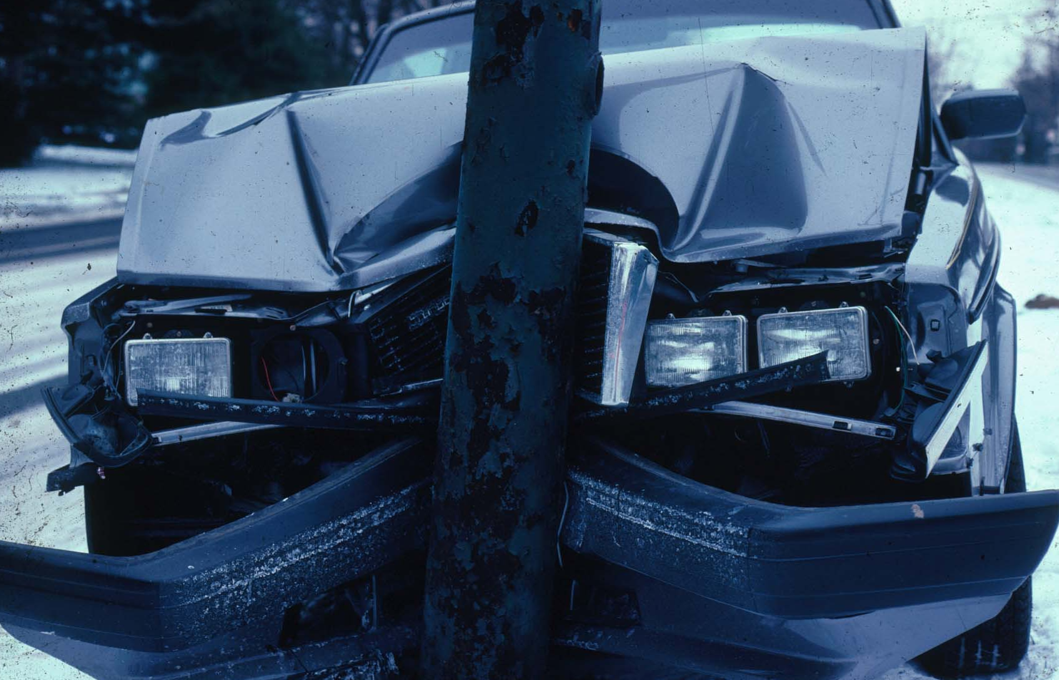
A study of over 27,000 Shock Trauma
Center patients followed up to 14 years.
The death rate from a repeat trauma
episode was 2 times higher for
pts who tested for alcohol/drug

Slide 13
Methods
Study period: FY 84 - FY 95
All patients discharged alive from trauma center and tested for alcohol (over 95% all cases)
Mortality follow-up
Follow-up period: 1.5 - 14.5 years
Mortality search based on name and SS#
Death certificates obtained each state
  Very time consuming and labor intensive
Abstraction of cause of death data
  When available and not electronic
Survival analysis

Slide 14
Results:
Overview of Study Population
(N=27,399)
Mean age= 34 years (80% < 45 years old)
72.6% male
68.5% white
80.7% unintentional injury
57.2% ISS 9 or greater
78.0% discharged to home

Slide 15
Follow-up of Cases

Slide 16
Toxicology Findings among the Cohort of 27,399 Patients*
42.2% had any positive toxicology
31% had evidence of alcohol, + - drugs
* 93.5% of original cohort was tested

Slide 17
Survival Rates for All Cause Mortality Stratified by admission toxicology status and age

Slide 18
Survival Rates for Injury Mortality Stratified by admission toxicology status and age

Slide 19
Higher Risk of Injury Mortality in TOX+ Group Relative to TOX- Group
RR 95%CI
Age < 45 years 2.33 1.83-2.98
Age 45+ years 1.40 0.90-2.19
Total cohort 2.07 1.68-2.55

Slide 20
Conclusions
Patients with positive alcohol/drug tests at the time of trauma center admission were more likely to die a premature death as the result of injury
Among patients <45 years old, those with a positive toxicology finding had a significantly higher injury mortality rate
Study did not have the power to look at how BAC level predicts mortality
  New study much larger study size (10X)
    Able to examine actual BAC levels
Difficulty obtaining death certificates from each state
  Lack multiple cause data
National Death Index a more efficient way to identify deaths and used in our new study

Slide 21
Alcohol Involvement in a Cohort of Trauma Patients: Trends and Future Mortality
New NIH grant builds on earlier study
Hypothesis: Risk of subsequent mortality following trauma admission increases dramatically as BAC increases
Link 26 years trauma admissions with National Death Index
Over 1 million person years of follow-up
Use of data linkage to inform clinical practice
  E.G. A BAC over 150mg/dl is a medical emergency as person has such a high risk of dying of another injury

Slide 22
Alcohol Involvement in a Cohort of Trauma Patients: Trends and Future Mortality
Linkage of 26 years of Shock Trauma discharges to the National Death Index (NDI)
Social Security number, name, DOB sent to NDI
  Determine those who die
  Multiple causes of death
  Over 1 million person years of follow-up
  Builds resource for trauma registry to passively follow mortality on all STC cases for other mortality follow-up studies
  Supported by: NIAAA Grant #1R01AA18707

Slide 23
Activities across the pond
Australia
  Western Australia used data linkage since 1970s.
  http://www.datalinkage-wa.org.au/
  SA·NT DataLink provides secure method of data linkage for research without linking data itself
    https://www.santdatalink.org.au/
    Centre for Health Record Linkage (CHeReL) Creates and maintain record linkage for NSW and ACT
International Health Data Linkage Network
  http://www.ihdln.org/

Slide 24
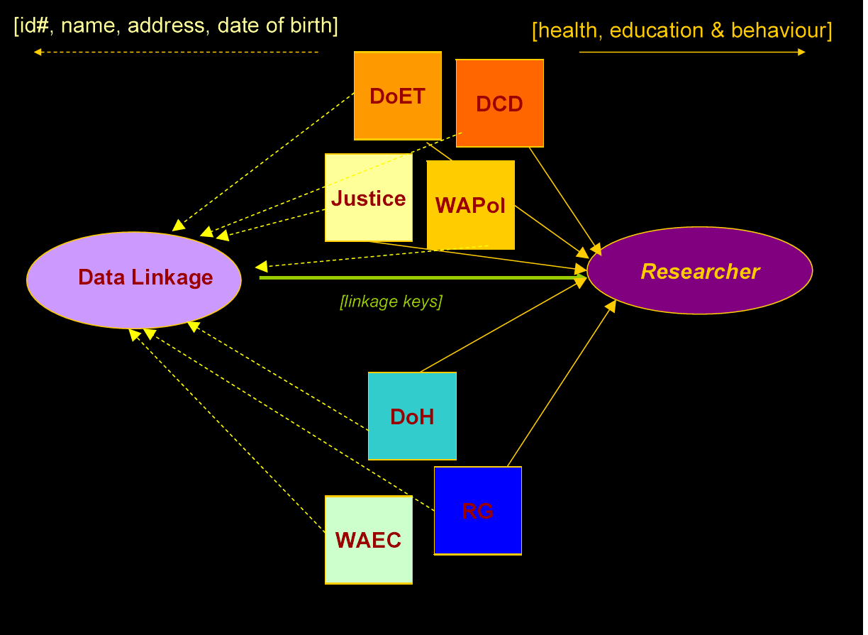
Data linkage Western Australia

Slide 25
New Zealand
Long history of data linkage
Health Identification number
  Allows linkage of health data sources
    Identify repeat admissions
    Link prior hospitalization with mortality data
Link hospital and traffic crash records
  “substantial numbers of cyclist only crashes.. not captured in the TCR database. Langley Inj Prev 2003;9:376-379

Slide 26
New Zealand ACC
Linkage of Trauma Registry and Accident Compensation Corporation Data
  Investigating the impact of major trauma in childhood (Jackson, Kool, Christie, Hamill, Dansey, Ameratunga)
Determined the feasibility of linking trauma registry data with ACC data
Provides opportunity to link hospital data with long-term health data on injuries
Similar to workers compensation for all injuries
a foundation for subsequent scientific research
  inform priority setting in injury prevention
  assess trauma system effectiveness
  opportunities for intervention

Slide 27
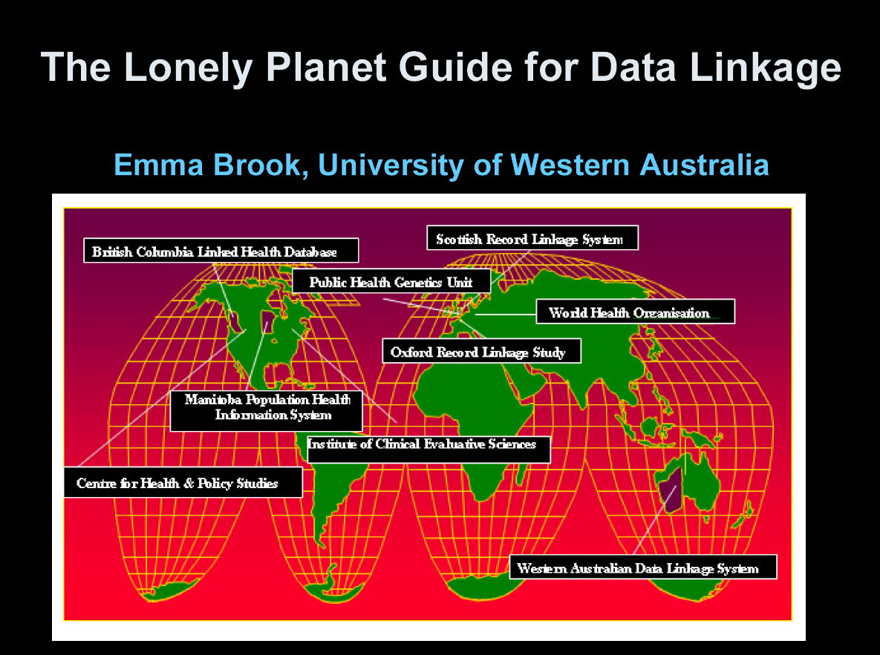

Slide 28
Questions???
Dr. Gordon Smith
gssmith@som.umaryland.edu
410-328-3847

