Slide 1
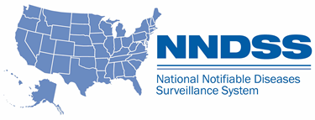
NNDSS eSHARE February 2023 Webinar
Division of Health Informatics and Surveillance
February 21, 2023

Slide 2
Agenda
NNDSS Updates and Announcements
CDC Case Surveillance Modernization Updates
Case Surveillance Data Standardization—Paving the Way for Increased Interoperability
Questions and Answers

Slide 3
NNDSS Updates and Announcements
Michele Hoover, MS
Data Standardization and Assistance Team (DSAT)
Office of Public Health Data, Surveillance, and Technology

Slide 4
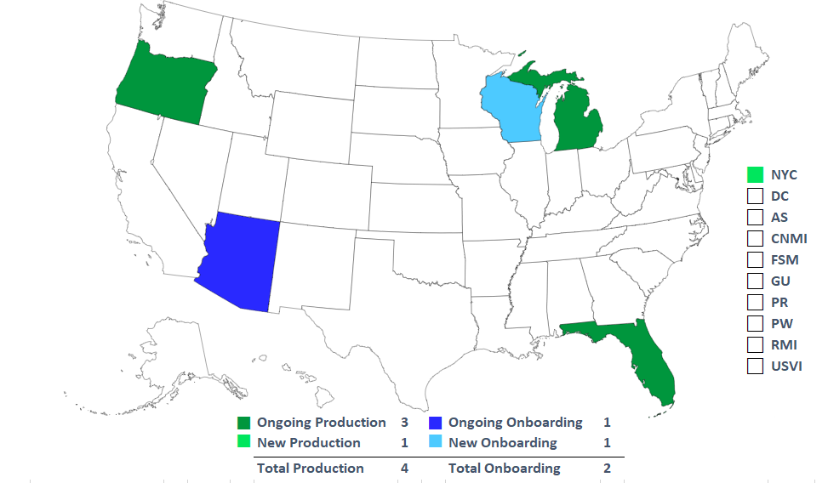
Tuberculosis and Latent TB Infection (LTBI) Message Mapping Guide (MMG) Implementation
Status as of 2/21/2023
16 in TB Cohorts
7 receiving individual technical assistance

Slide 5
Case Surveillance Modernization Updates
Danielle Tack, DVM, MPVM, DACVPM
Data Standardization and Assistance Team Lead
Office of Public Health Data, Surveillance, and Technology

Slide 6
Progress Highlights
Recommendation | Status | Planned Actions
Prioritize onboarding of all jurisdictions and conditions onto a generic, core data feed | MITRE landscape analysis for GenV2 core data elements delayed due to contract process estimated to start March, trying to expedite and start sooner | Documentation prep and prioritization of jurisdictions
Pause creation of new disease-specific MMGs | Working through action items from meetings; programs awaiting DSAT followup should begin receiving items | Finalize plans based on program meetings and feedback to further define implementation of US Digital Service recommendations
Pause disease-specific MMG onboarding | Continued assessment based on jurisdiction outreach Working on adjusting some processes for NBS pages with no NNDSS legacy data | Use of Epidemiology and Laboratory Capacity-Health Information System (ELC-HIS) calls to fill in gaps in MMG status Develop specific guidance for ELC HIS on where MMG efforts could be refocused Use of MMG content to inform surveillance efforts
Develop case reporting data dictionary | Working with CDC Data Modernization Initiative (DMI) priority team 2 (core data for situational awareness) & DMI priority team 1c (CDC case data landscape analysis) Assessing tools to assist with standardization Working with Council of State and Territorial Epidemiologists (CSTE) to convene jurisdictions and CDC programs to work through data element standardization | Continue work with DMI priority team and CSTE to identify best next steps to use developed MMGs and other inputs to move toward standard data elements If interested in joining the CSTE Data Standardization Workgroup, please email Becky Lampkins (blampkins@cste.org)

Slide 7
Questions or Feedback?
Use this Jurisdiction feedback form
Visit our Frequently Asked Questions page
We look forward to hearing from you!

Slide 8
Case Surveillance Data Standardization—Paving the Way for Increased Interoperability
Sara Johnston, MPH, NNDSS Program Lead
Office of Public Health Data, Surveillance, and Technology

Slide 9
Drivers for Standardization and Harmonization Efforts
Responds to jurisdictions’ requests
Advances health equity work
Identifies basic information needed for emergency responses (COVID-19, mpox)
Supports preparedness by setting up data elements before we know the condition
Facilitates interjurisdictional data exchange
Streamlines the case data flow (electronic health record [EHR], jurisdiction surveillance systems, CDC)

Slide 10
High-level Goal Data standardization across the case surveillance ecosystem results in greater interoperability and automation, leading to increased efficiency

Slide 11
The future is ours to create.

Slide 12
What is “Generic” or “Core”’ Data for a Case?
Jurisdiction surveillance systems are set up with data elements that are present for any condition.
Includes contact info, demographics, case classification status, onset date, diagnosis date, and dates related to reporting or entry in the system

Slide 13
What if We Expand the ”Core” Data?
This means we are asking for the data the same way across all conditions.
It allows jurisdictions to include these new “expanded core” data elements in their system as general data elements for any condition.
Setting up a new condition to include these data elements should be easier because the format for collecting and sending is already there.

Slide 14
What Should the “Expanded Core” Look Like?
There are common categories of information collected during public health investigations.
What is common across MMGs?
Use existing standards
What comes into the surveillance system in a standardized way (electronic lab reporting [ELR], electronic case reporting [eCR], vaccine history)?

Slide 15
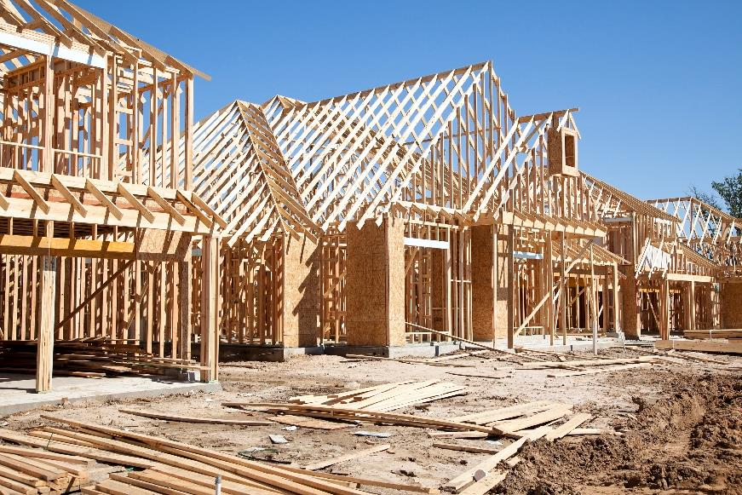
What Does the Case Data Structure Look Like? (Example)
Case demographics
Core demographics
SOGI¹ and SDOH²
Industry and occupation
Pregnancy
Clinical
Hospitalization
Underlying conditions
Signs and symptoms
Treatment
Risk factors/exposures
Travel history
Lab test information
Vaccination
Death
Public health process info
¹SOGI: sexual orientation and gender identity
²SDOH: social determinants of health

Slide 16
Where Do the Data Come From?
Case demographics
Core demographics
SOGI¹ and SDOH²
Industry and occupation
Pregnancy
Clinical
Hospitalization
Underlying conditions
Signs and symptoms
Treatment
Risk factors/exposures
Travel history
Lab test information
Vaccination
Death
Public health process info
Jurisdiction
Immunization Registry
Health Care
Public Health Investigation
Vital Records
Laboratory
Outbreak & Contact Tracing
¹SOGI: sexual orientation and gender identity
²SDOH: social determinants of health

Slide 17
Importance of Aligning Data Throughout the Case Surveillance Ecosystem

Slide 18
Standardization Matters
Our lives operate on it.

Slide 19
Standardization in Health Care and Public Health
Efforts to standardize and promote interoperability across EHR systems provided a common language and led to more data available
Public health needs to capitalize on the efforts in health care and apply the same principles to public health data exchange
Standardization of data from health care, data held in jurisdiction surveillance systems, and data requested by CDC will result in more data available to those who need it

Slide 20
Data Flow Example
3
4
Patient Interview
Case Review and Classification
Can jurisdictions use a standard framework for transferring cases to other jurisdictions?
1
Electronic Laboratory Report
Surveillance System
Race: Unknown Asian Pacific Islander
Medication: Antibiotic A (prescribed)
Antibiotic A (completed)
Classification: Confirmed
Message Mapping Guides
Race?
Medication?
Classification?
2
Electronic Initial Case Report (eICR)
Can jurisdictions consume and store data in the same way across conditions?
Can CDC ask for data in the same way across conditions?

Slide 21
What Should the Future Look Like?
Automated…
electronic reporting from labs and health care
consumption of the reports into the jurisdiction surveillance system
linkage with other systems (e.g., immunization registry, death registry, health information exchange [HIE], etc.)
review of the available case data for case classification status assignment (when available data are enough to classify)
data analysis and visualization for decision-making
electronic notification sent to CDC for cases meeting notification criteria (based on classification)
notification processing and “translation” of data into epi-friendly concepts (e.g., lab observation LOINC and SNOMED-CT codes)

Slide 22
Data Standardization is the Key
For systems to talk to each other
and share automated services,
they must speak the same language.

Slide 23
CSTE/CDC Collaboration: Case Data Element Standardization
CSTE/CDC collaboration:
Case data element standardization

Slide 24
CSTE Data Standardization Work Group will bring together jurisdictions, CDC programs, and other SMEs to discuss and make recommendations on standardization of data elements

Slide 25
Data Element Discussions
How it is represented in other standards (eCR, ELR, and other HL7/FHIR)
Related data elements in U.S. Core Data for Interoperability (USCDI) & USCDI+
Other standardization work completed or ongoing
How it is represented across case notification message mapping guides (MMGs)
Feedback received from jurisdictions and CDC programs
Other?

Slide 26
Prioritizing Data Elements to Work On
Factors to consider:
Considered core data, maybe already standard across conditions
Very common across conditions (although may not be standardized across conditions)
Other standardization work is going on
+ Well established standard exists
- Standards work underway will inform our action (may want to wait)
Pain points for jurisdictions or CDC
Simplicity – what can we make progress on in the shorter term?
Data that results in public health action, importance of the data
Part of the emergency response case surveillance data elements?
Others?

Slide 27
Potential Data Classes
Health Equity/Social Determinants of Health (SDOH)
Sexual Orientation and Gender Identity (SOGI)
Pregnancy
Tribal affiliation
Race/ethnicity
Disability
Industry and occupation
Travel
Hospitalization
Underlying conditions, exposures, and risk factors
Signs and symptoms/clinical manifestation
Laboratory observations
Immunization history
Medications
Reporting source & information source
Case identifiers, including CDC emergency response case ID
Lab identifiers (to link case and lab data)
Other?

Slide 28
This case data standardization effort will:
Create standards for data across the case surveillance ecosystem​
Benefit jurisdiction surveillance systems and processes, including
inter-jurisdictional sharing or transfer of case data
(e.g., local to state, or state to state)​
Coordinate with the CDC emergency response case data element project​
Inform the new data dictionary for case notification to CDC​

Slide 29
What’s Next?
Join the Data Standardization Work Group: last Friday of each month at 1pm EDT
Next meeting: February 24, 2023
Topic: Hospitalization
Email Becky Lampkins, CSTE, at blampkins@cste.org for the invite

Slide 30
Thank you! See you March 21, 2023, for the next NNDSS eSHARE
Subscribe to Case Surveillance News
Access NNDSS’ Technical Resource Center
Email edx@cdc.gov for technical help
Learn about case surveillance modernization
The findings and conclusions in this report are those of the authors and do not necessarily represent the official position of the Centers for Disease Control and Prevention.

