Slide 1
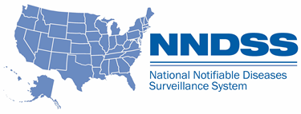
NNDSS eSHARE August 2024 Webinar
Centers for Disease Control and Prevention
August 27, 2024
Office of Public Health Data, Surveillance, and Technology

Slide 2
Agenda
NNDSS Updates/Announcements
Minimal Data Necessary (MDN)
Overview
Implementation for Case Notification
Questions and Answers

Slide 3
CDC/CSTE Data Standardization Workgroup (DSWG) Updates
Angie Agunloye, MPH, RHIA Health Scientist Office of Public Health Data, Surveillance, and Technology

Slide 4
CSTE DSWG Data Standard and Harmonization Effort​
Focus on developing and recommending standardized data elements and terminology for use across various public health data systems.
Initial Use Case: The DSWG’s work began with case notification as a practical and critical use case, laying the foundation for broader data standardization efforts.
Focus on standardization of core data for routine, condition-agnostic case data collection
Does not address condition-specific data or needs beyond shared core data
4

Slide 5
List of Data Classes ​
Hospitalization
Travel
Pregnancy
Sexual Orientation and Gender Identity (SOGI)
Industry and occupation
Immunization history
Death
Underlying conditions, exposures, risk factors
Signs and symptoms/clinical manifestation
Disability
Case identifiers/Lab identifiers
Medications
Reporting source & information source
Laboratory observations
Race/ethnicity/Tribal affiliation
Social Determinants of Health (SDOH)
5

Slide 6
Example: Data Standardization for Death Data Class
Current
Did the subject die from this illness or complication of this illness?
If subject died from illness, indicate date of death
Review of existing standards
Indicates whether or not patient is deceased
Electronic Case Reporting (eCR):
deceasedInd: Records that the patient is deceased
deceasedTime: Records date and time of death
United States Core Data for Interoperability (USCDI):
Known or estimated year, month, and day of the patient's death
Electronic Lab Reporting (ELR)
Indicator that the patient is deceased
Date of Death
Indicator if death associated with condition being reported
Recommendation
Date and time at which death occurred
6

Slide 7
Upcoming Calls/Discussions
Data Class | Status
Lab | Second Call: Friday, September 13th at 1-2 PM ET
Social Determinants of Health (SDOH) | First Call: Friday, 9/20/24 at 1-2 PM ET. Will focus on residence type as it impacts homeless and incarceration. Future calls will be focused on other areas such language, education, insurance coverage, and income.
Full DSWG call | Occurs every Friday of every other month. Next call would be 8/30/24, 1-2 PM. If you are registered for any data class teams, you will receive this appointment.
7

Slide 8
How to Get Involved
Join Our Discussions:
If you’re interested in engaging with the DSWG or participating in our upcoming calls, we welcome your involvement.
Contact Information
Angie Agunloye
Email: oes8@cdc.gov
Stay Connected
Your expertise and input are crucial to the success of our standardization efforts. We look forward to your participation!
8

Slide 9
Annual Reconciliation of 2023 NNDSS Data
Courtney Cook, MS Epidemiologist Office of Public Health Data, Surveillance, and Technology

Slide 10
2023 Reconciliation: Finish Line!
Our deadline for completing reconciliation was August 23. This included:
Approval of data in Message Validation, Processing, and Provisioning System (MVPS).
Approval of 2023 mpox cases in Data Collation and Integration for Public Health Event Responses (DCIPHER).
Submission of COVID-19 Epi InfoTM form with 2023 aggregate counts or 2023 reporting exception.
Thank you for your hard work in reconciling your 2023 NNDSS data!
We welcome any feedback you may have on the reconciliation process as we prepare for 2024 reconciliation.
Please send to edx@cdc.gov with “Reconciliation Feedback” in the subject line.
10

Slide 11
MVPS Updates: New “Members” Feature

Slide 12
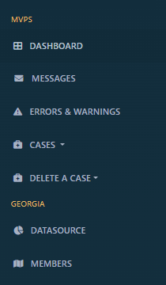
New MVPS Feature: Members
MVPS has released a new feature allowing users to view the roles of all jurisdiction staff with MVPS accounts.
12

Slide 13
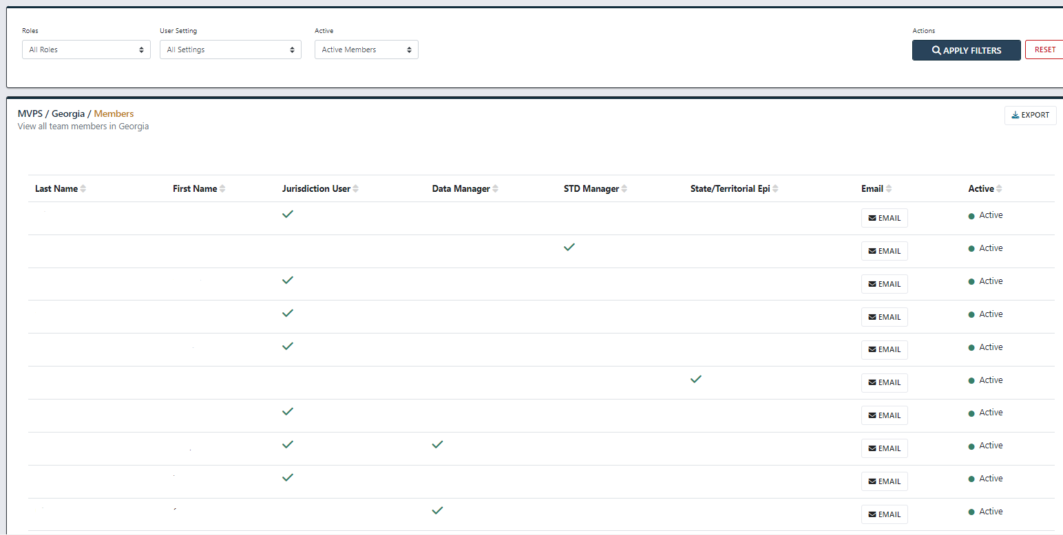
New MVPS Feature: Members
13

Slide 14
Minimal Data Necessary (MDN)
Anne McIntyre, PhD, MPH and Sally Rodriguez
Detect and Monitor Division
Office of Public Health Data, Surveillance, and Technology

Slide 15
Agenda​
Office of Public Health Data, Surveillance, and Technology (OPHDST) Organizational Chart
Minimal Data Necessary (MDN) Overview
Implementing the MDN for Case Notification
Discussion/Questions & Answers

Slide 16
Office of Public Health Data, Surveillance, and Technology (OPHDST) Organizational Chart

Slide 17
CDC’s Office of Public Health Data, Surveillance and Technology (OPHDST)
Office of the Director
Detect and Monitor Division
Enables rapid detection on the state and local levels, tracks diseases and conditions nationally, and improves surveillance capabilities of State, Tribal, Local and Territorial (STLTs), federal partners and internal officers​
Investigate and Respond Division
Empowers STLTs and other Public Health (PH) actors with the tools to investigate, prevent and minimize PH risks and innovate to bolster future responses
Inform and Disseminate Division
Provides the public and PH decision-makers timely and actionable data, data products and analytic insights to guide decisions​
Data Policy and Standards Division
Helps set and interpret data and technology policy and standards to ensure data transmitted across the PH ecosystem is robust, interoperable and conforms to open data policies
Platforms Division
Ensures that data used across CDC is robust and as accessible as possible, and to make reusable and shareable technologies available across the PH ecosystem
17

Slide 18
CDC’s Office of Public Health Data, Surveillance and Technology (OPHDST)
Office of the Director
Detect and Monitor Division
Enables rapid detection on the state and local levels, tracks diseases and conditions nationally, and improves surveillance capabilities of State, Tribal, Local and Territorial (STLTs), federal partners and internal officers​
Investigate and Respond Division
Empowers STLTs and other Public Health (PH) actors with the tools to investigate, prevent and minimize PH risks and innovate to bolster future responses
Inform and Disseminate Division
Provides the public and PH decision-makers timely and actionable data, data products and analytic insights to guide decisions​
Data Policy and Standards Division
Helps set and interpret data and technology policy and standards to ensure data transmitted across the PH ecosystem is robust, interoperable and conforms to open data policies
Platforms Division
Ensures that data used across CDC is robust and as accessible as possible, and to make reusable and shareable technologies available across the PH ecosystem
18

Slide 19
CDC’s Office of Public Health Data, Surveillance and Technology (OPHDST)
Office of the Director
Detect and Monitor Division
Enables rapid detection on the state and local levels, tracks diseases and conditions nationally, and improves surveillance capabilities of State, Tribal, Local and Territorial (STLTs), federal partners and internal officers​
Investigate and Respond Division
Empowers STLTs and other Public Health (PH) actors with the tools to investigate, prevent and minimize PH risks and innovate to bolster future responses
Inform and Disseminate Division
Provides the public and PH decision-makers timely and actionable data, data products and analytic insights to guide decisions​
Data Policy and Standards Division
Helps set and interpret data and technology policy and standards to ensure data transmitted across the PH ecosystem is robust, interoperable and conforms to open data policies
Platforms Division
Ensures that data used across CDC is robust and as accessible as possible, and to make reusable and shareable technologies available across the PH ecosystem
19

Slide 20
Detect and Monitor Division
Integrated Monitoring Branch
Public Health Data Transmission Branch
NSSP
NNDSS
MVPS
eCR
ReportStream

Slide 21
Public Health Data Transmission Branch (PHDTB)
Anne McIntyre, Chief
Jim Duff, Technical Co-Lead
Data Evaluation and Surveillance Operations Team
Data Transmission Team
Product Development and Operational Support Team
Michelle Lin, Lead
NNDSS Program
Laura Conn, Lead
Message Mapping Guides (MMG)
eSHARE
eCR
Andrew Kuehl, Lead
MVPS

Slide 22
Minimal Data Necessary (MDN) for Case Notification During Public Health Response

Slide 23
Minimal Data Necessary (MDN): Background
Initiated in 2021 as part of the Data Modernization Initiative (DMI)
CDC Advisory Committee to the Director (ACD) Data and Surveillance Workgroup (DSW) Report (November 2022)
Recommendation #1: “Define the Minimal Data Necessary for Core Public Health Data Sources”
Case data
Laboratory-based diagnostic testing data
Syndromic surveillance/emergency department data
Immunization/vaccine administration data
Hospital capacity data
Death data (vital statistics) data
23

Slide 24
Overview of MDN for Case Notification
Collaborators | CDC, CSTE
Description | Minimum list of line-level case data to be shared between STLTs and CDC in the beginning of a response for national situational awareness
Purpose | Provide guidance and structure for jurisdictions to collect the data elements needed at the beginning of an emergency to: Support response readiness Reduce the burden on STLT partners
Content | Best attempt to define the 80% of line-list data needed on cases at the beginning of an emergency response/event Represents a subset of GenV2 plus new data needed for national situational awareness

Slide 25
MDN Data Elements
What
Condition and category
Link to known outbreaks
Whether and what symptoms are present
Lab tests
Who
Number of people affected
Demographics
Pregnancy status
Underlying medical conditions
Outcomes: were they hospitalized? Did they die?
Why
Exposures
Travel exposures
When
Dates of symptom onset, diagnosis, lab results, case occurrence, death
Data are entered into STLT system, sent to CDC
Where
Jurisdiction

Slide 26
Implementing the MDN for Case Notification Data

Slide 27
MDN at CDC
CDC is implementing an agency-wide approach to collecting the MDN for emergency response
MDN for case notification is first
Detect and Monitor Division is leading implementation
Office of Readiness and Response is a critical player and communications partner
DSWG is harmonizing data elements, classes

Slide 28
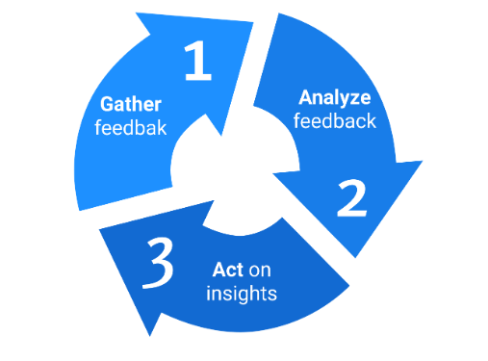
MDN Implementation Needs Continuous Feedback
Agile development: the feedback cycle
Gather feedback
Analyze feedback
Act on insights

Slide 29
Next Steps for MDN Implementation
Within CDC: planning and prioritizing program adoption
Guidance for STLTs: formulating options and timelines
Ongoing communications
eSHARE webinars in September and beyond will provide deeper dives into the MDN and implementation plans

Slide 30
Your Feedback: What Do You Need From CDC?
As we prepare for upcoming eSHARE webinars and other communications:
What are the key questions CDC needs to address?
What are your concerns about MDN implementation?
What support should CDC provide to improve the implementation process?
Other questions? Feedback?
Please send any questions or feedback related to the MDN for case to:
MDN-CASE@CDC.GOV

Slide 31
Q & A

Slide 32
Thank you! Next NNDSS eSHARE: September 17, 2024
Subscribe to Case Surveillance News
Access NNDSS’ Technical Resource Center
Email edx@cdc.gov for technical help
Learn about case surveillance modernization

