Slide 1
Community Reception Center Electronic Data Collection Tool (CRC eTool) Just-in-Time Training
Created by: Ekta Choudhary, PhD, MPH
Emergency Management, Radiation, and Chemical Branch
Division of Environmental Health Science and Practice
Notes:
This is the “Just-in-Time” training for users of the Community Reception Center (CRC) Electronic Data Collection Tool or CRC eTool.

Slide 2
Outline
Background
Improvised nuclear device (IND) detonation
Expected injuries
Community reception centers (CRCs)
CRC Electronic Data Collection Tool (CRC eTool) Training
Notes:
This training is designed to provide a brief introduction on improvised nuclear device (IND) detonation, expected injuries to individuals, and the role of CRCs in population monitoring after IND detonation. This training will also show how to use the CRC eTool for data collection at a CRC.

Slide 3
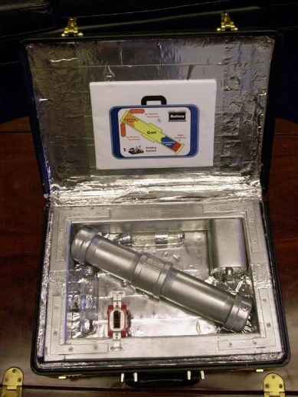
Improvised Nuclear Device (IND)
Think Hiroshima “Little Boy”
Low-yield kiloton range
Possible tool of terrorism
No warning
Notes:
What is an Improvised Nuclear Device (IND)?
A nuclear emergency involves the explosion of a nuclear weapon or an improvised nuclear device (IND), similar to the one used in Hiroshima but with low kiloton yield.
IND detonation may be intentional and a possible tool of terrorism. It will most likely occur with no warning.

Slide 4
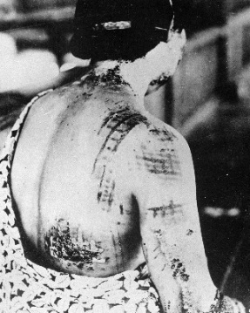
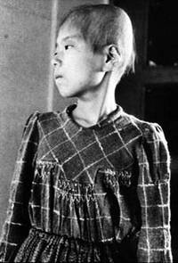
Expected Injuries Following IND Detonation
Trauma
Thermal burns
Radioactive burns (fallout)
Radioactive contamination
Acute radiation syndrome
Notes:
An IND would cause widespread destruction, injury, and death. People close to the blast site could experience
Injury or death (as a result of the blast)
Moderate to severe thermal and radiation burns from the nuclear fallout. “Fallout” is the name for minute particles of radioactive debris that descend slowly from the atmosphere after a nuclear explosion (https://www.remm.nlm.gov/dictionary.htm#f)
Burns and wounds can be contaminated by deposition of radioactive material from the IND detonation.
Radiation sickness, also called “acute radiation syndrome” or ARS—A person exposed to radiation will develop ARS only if the radiation dose was high and penetrating (e.g., x-rays or gamma rays), encompassed most or all of the body, and received in a short period of time. (https://www.remm.nlm.gov/dictionary.htm#letter_a)

Slide 5
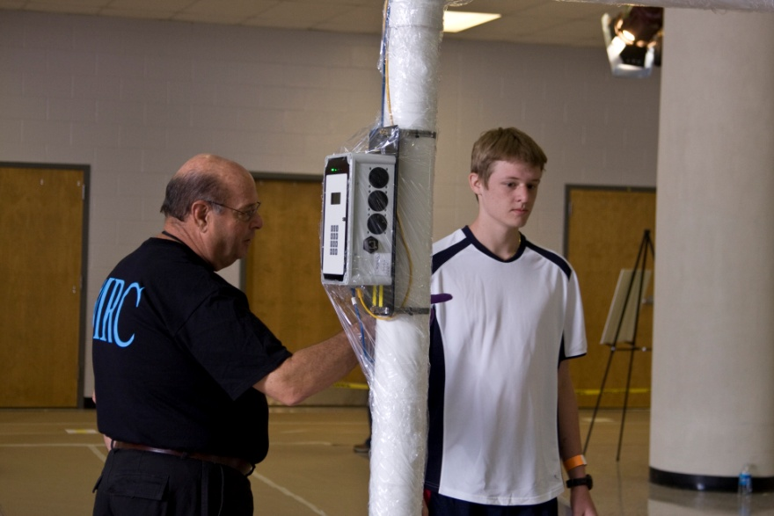
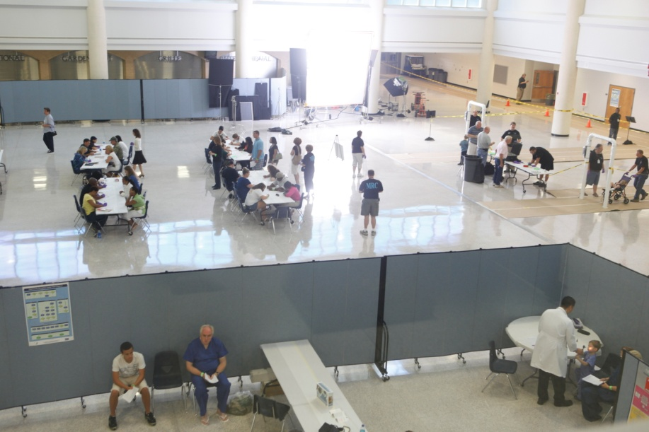
Community Reception Centers (CRCs)
Local response strategy for conducting population monitoring
Multi-agency effort
Opened 24–48 hours post incident
Located outside affected zones
Notes:
A radiation incident impacting a large population will require local response authorities to establish one or more population monitoring and decontamination facilities to assess people for exposure, contamination, and the need for decontamination or other medical follow-up. These facilities are known as “community reception centers (CRCs)”.
CRCs should be located outside the affected area and be operational within 24 to 48 hours after an incident or sooner if resources are available.

Slide 6
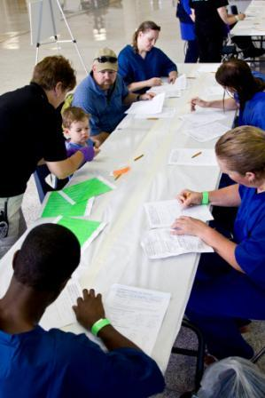
Benefits of CRCs
Main purpose: prioritize people for further care
Ease burden on hospitals
Manage scarce medical resources
Services
Contamination screening
Decontamination
Registration for subsequent follow-up
Prioritization for medical care
Notes:
CRCs are especially beneficial in reducing the potential burden on hospitals and maximizing scarce medical resources. They also support the operations of public and special needs shelters that will be hosting the displaced population.
The basic services offered at a CRC include the following: screening people for radioactive contamination, assisting people with washing or decontamination, registering people for subsequent follow-up, and prioritizing people for further care.

Slide 7
Role of CRCs
Shelter
Home
Shelter
CRC
Hospital
Shelter
Displaced Population
Home
CRC
Shelter
Hospital
CRC
Shelter
Home
Shelter
Notes:
This graphic shows the role of CRCs in guiding the displaced population. The CRC is the first step in moving the displaced population to the appropriate destination., It provides the essential services of contamination control, medical prioritization, and patient tracking that will streamline efforts to provide additional care and follow-up services.

Slide 8
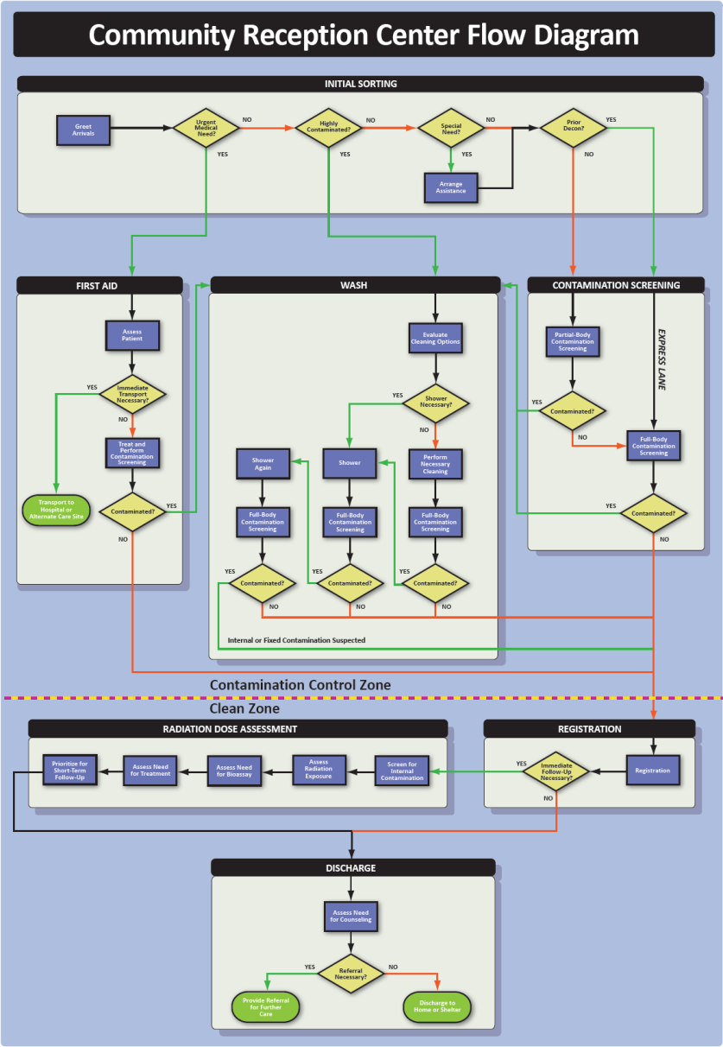
CRC Layout
7 Stations
Contaminated zone
Initial sorting
First aid
Contamination screening
Wash
Clean zone
Registration
Radiation dose assessment
Discharge
Notes:
This flow diagram shows the layout of the CRC and the flow of individuals based on their exposure and medical needs. There are seven main stations at a CRC: four are located in the contaminated zone:
Initial sorting
First aid
Contamination screening
Wash or decontamination
Three stations are located in the clean zone:
Registration for follow-up purposes
Radiation dose assessment
Discharge

Slide 9
Initial Sorting Station
Staff identify people who have:
Urgent medical needs
High levels of contamination
Special needs
Prior decontamination
Notes:
The Initial Sorting Station is where staff put people on the correct path through the CRC. Staff here identify people who have:
Urgent medical need,
High levels of contamination,
Special needs, or
Prior decontamination.

Slide 10
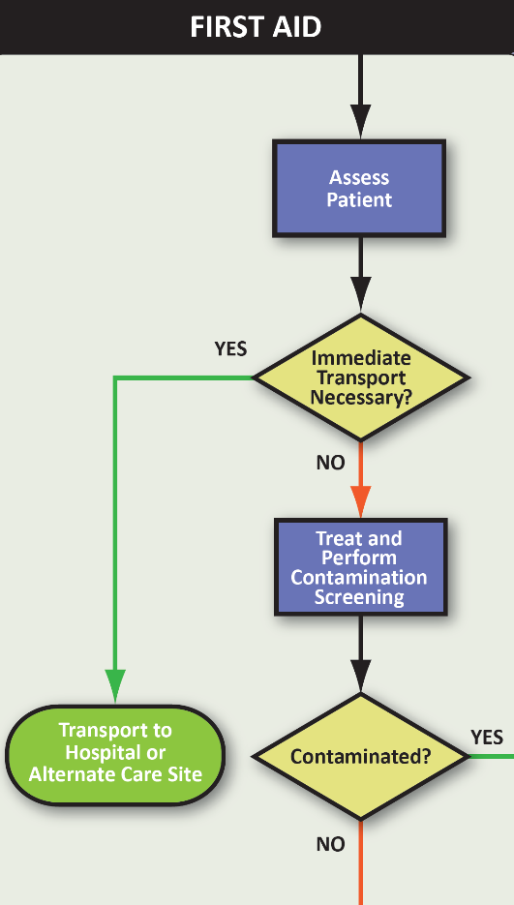
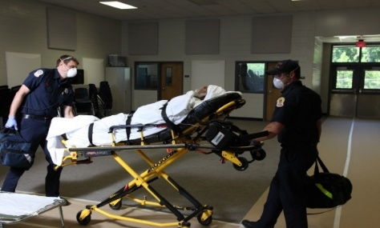
First Aid Station
Medical staff provide immediate care
Treat minor injuries on-site
Arrange emergency transport for severe illness or injury
Life saving care takes priority
Do not delay transport for decontamination
Notes:
People with urgent medical needs go to the First Aid Station for medical care and possible transport to a medical facility or alternate care site.
An urgent medical need is defined as any medical condition that requires immediate medical attention. This could include cardiac arrest, heat injuries, or open wounds that could potentially be contaminated or get contaminated in the CRC.
Life saving care should not be delayed for extensive decontamination – removing the outer layer of clothing is sufficient.

Slide 11
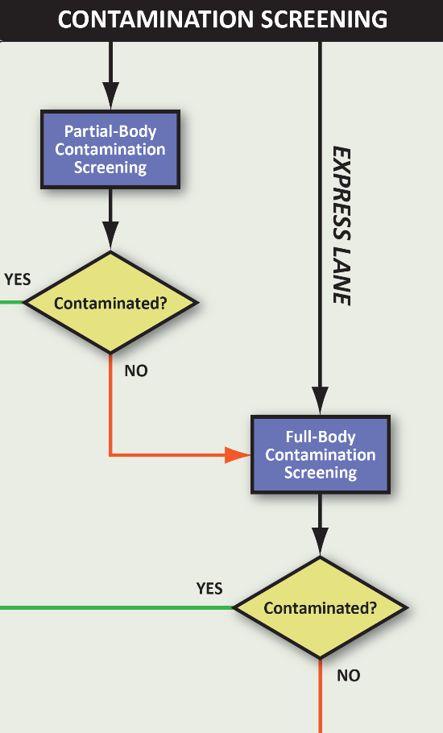
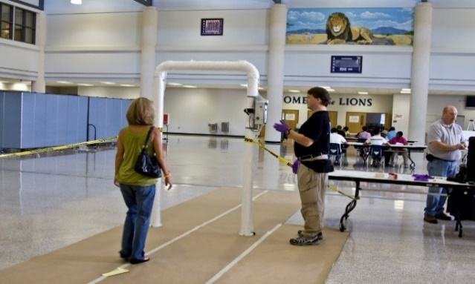
Contamination Screening Station
Staff screen people for contamination
Handheld instruments or portal monitors
Express lane for people with prior decontamination
Consult state radiation control authority for guidance
Notes:
The Contamination Screening Station is where staff monitor people for external contamination.
Staff can use a combination of partial-body and full-body screenings, using either handheld detectors or portal monitors, to screen for contamination. Also, an express lane may be established for people who decontaminated before coming to the CRC.
People who are contaminated go to the Wash Station for decontamination. People who are not contaminated go to Registration.

Slide 12
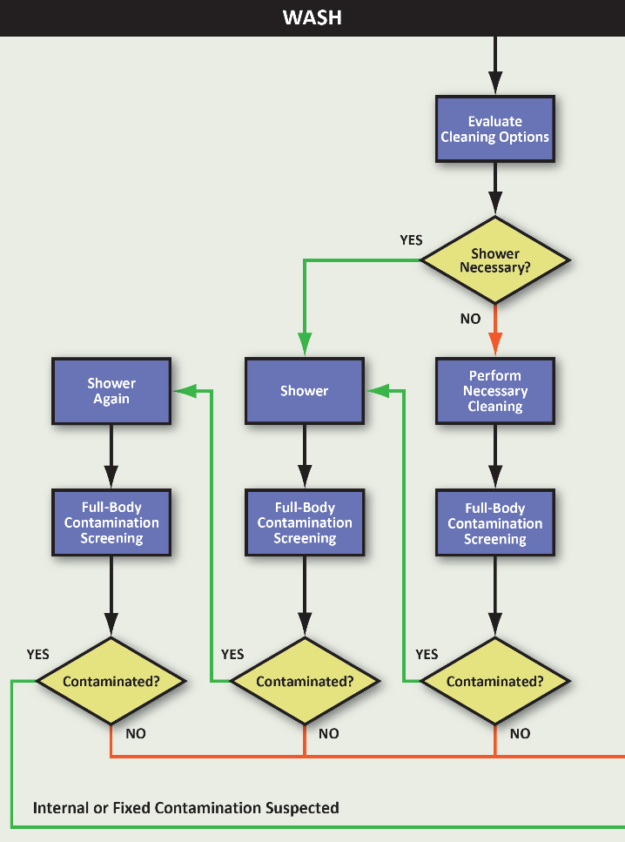
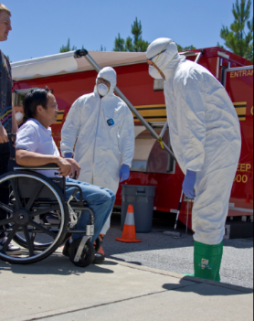
Wash Station
Staff facilitate showering
People wash themselves
Indoor shower facilities or mobile decontamination units
Some may need multiple showers
Full-body contamination screening before going to Registration Station
Notes:
At the Wash Station, people clean themselves. Some people may need only minimal decontamination, such as washing their hands or removing the outer layer of their clothing.
Screening staff in the Wash Station will check people for contamination after they clean themselves. If contamination is still present after two showers, that person may be internally contaminated and will require additional screening at the Radiation Dose Assessment Station.

Slide 13
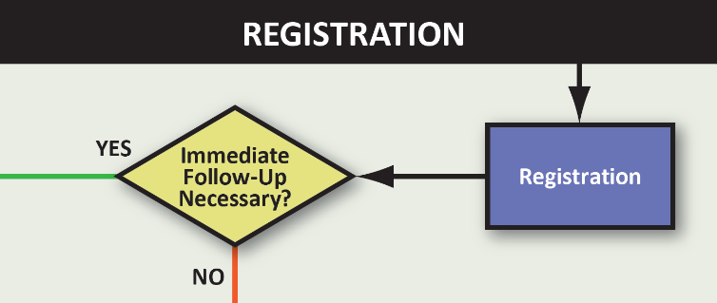
Registration Station
Staff use epidemiological tools to:
Establish a registry
Determine need for immediate follow-up at Radiation Dose Assessment Station
Information collected includes:
Demographic information
Destination
Proximity to event
Time in affected area
Notes:
After being screened for contamination or decontaminated at the Wash Station, people register with public health staff. Information collected at this station can be used to identify people who need immediate follow-up at the Radiation Dose Assessment Station. This information can also be used for long-term follow-up and tracking.

Slide 14
Radiation Dose Assessment
Clinical and health physics staff:
Screen for internal contamination
Assess radiation exposure
Assess need for bioassay
Assess need for treatment
Prioritize for short-term follow-up
Notes:
Staff at the Radiation Dose Assessment Station :
Screen people for internal contamination
Assess radiation exposure,
Assess the need for bioassay,
Assess the need for treatment, and
Prioritize people for short-term follow-up.
Not everyone at the CRC will be evaluated at the Radiation Dose Assessment Station. For example, pregnant women, people showing signs of acute radiation sickness, people who are suspected to be internally contaminated, and people who were externally contaminated when they entered the CRC, may be the only people referred for Radiation Dose Assessment.

Slide 15
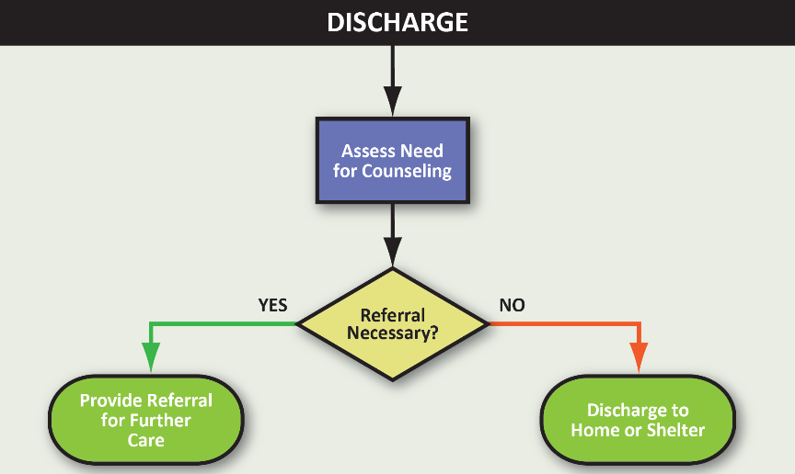
Discharge Station
Staff provide information for people leaving the CRC
Assess need for counseling
Discharge to home or shelter
Provide referral for further care
Notes:
Staff at the Discharge Station assess the need for counseling and provide referrals for further care. Staff here also provide information for people who are being discharged to their homes and facilitate placement in a public shelter.

Slide 16
CRC Data for Public Health Use
Characterization of affected population for situational awareness
Provision of epidemiological data to create registries for long-term follow-up
Identification of risk factors associated with particular environment or activities
Prioritization of limited medical resources such as countermeasures or bioassays
Improvement of dose reconstruction by collecting personal variables
Notes:
How CRC data can be used for public health?
Data collected at CRCs will be crucial for many public health response activities and will enable
Characterization of the affected population, including vulnerable/special populations, for situational awareness.
Provision of accurate epidemiological data that can be integrated into long-term registries for follow up of latent health effects after radiation exposure.
Identification of risk factors associated with particular environments or activities (proximity, being outdoors, etc.) for effective public health messaging.
Prioritization of limited medical resources such as countermeasures or bioassays for population groups that have a higher risk of exposure or internal contamination based on susceptibility factors.
Improvement of dose reconstruction accuracy by collecting personal variables needed in dose calculations.

Slide 17
CRC Electronic Data Collection Tool
CRC eTool Training

Slide 18
CRC eTool
Electronic data collection tool
Designed to collect, analyze, visualize, and securely exchange population monitoring data
Created using Epi Info™ 7 software
Networked tool which can be used by all stations
Notes:
The CRC eTool is designed to collect, analyze, visualize, and securely exchange population monitoring data. Based on the amount and complexity of the data, an ideal platform for data collection at a CRC is an electronic database tool such as Epi Info 7. A tool such as Epi Info 7 can be implemented using a local area network to include laptops, tablets, and cell phones, and paper as an alternative backup option. Data analysis, visualization, and transfer and exchange processes are also much more efficient once the data are collected electronically.

Slide 19
8 Stations: 7 CRC Stations + 1 Unregistered
Initial sorting
Radiation contamination screening
Wash
First aid
Registration
Radiation dose assessment
Discharge
Unregistered
Notes:
The CRC flow diagram shown earlier (in slide #9) showed that there are 7 main stations at a CRC. But the CRC eTool will show 8 stations. The 8th station is the station for unregistered individuals. This is NOT an official station at a CRC; therefore, it is not shown in the flow diagram.

Slide 20
Unregistered Station
Track individuals who use services
Estimate throughput
Collects contact information
Notes:
This station is created for those who refuse to provide information at a CRC at any time, i.e., people who don’t give consent to collect their exposure and/or personal information. This station is designed to keep track of incomplete records and also will help calculate the throughput at a CRC. Staff at this station will collect basic information, if provided by the individual.

Slide 21
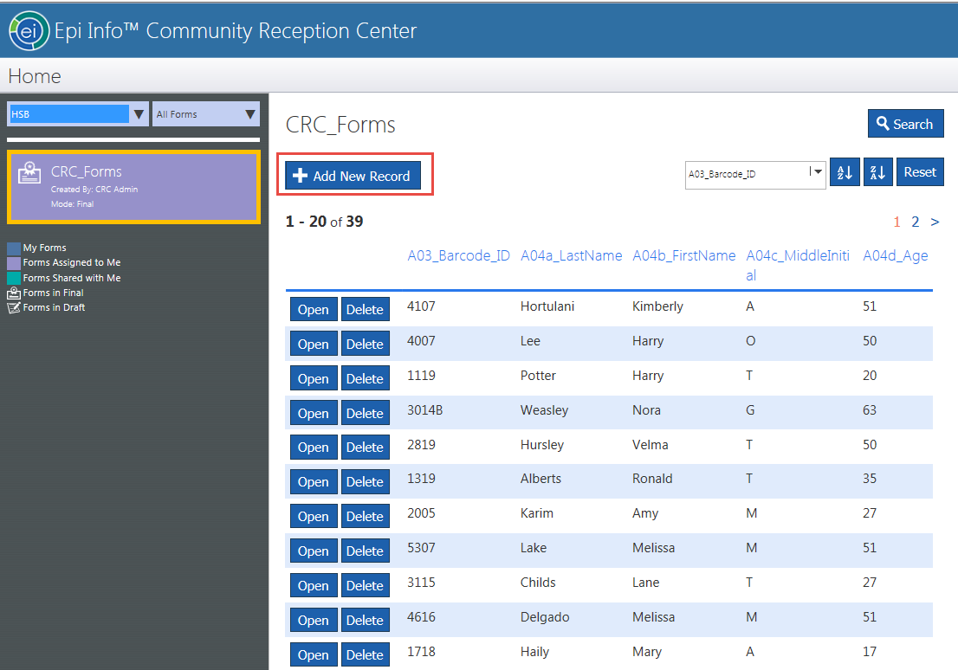
Main Screen and Line List
New records (i.e. new individuals) can ONLY be added by station staff members at “Initial Sorting”
Click “+ Add New Record” ONLY on the line list page
Notes:
The first screen of the CRC eTool that you will see is the main screen with the line list, which will show the list of all individuals who are being or have been processed at the CRC.
The main screen will also show the tab to “+Add New Record,” which Welcome Desk staff will use to add new individuals for processing at a CRC.
Please note that ONLY the staff at Welcome Desk should use the CRC eTool to add new individuals for processing at a CRC.

Slide 22
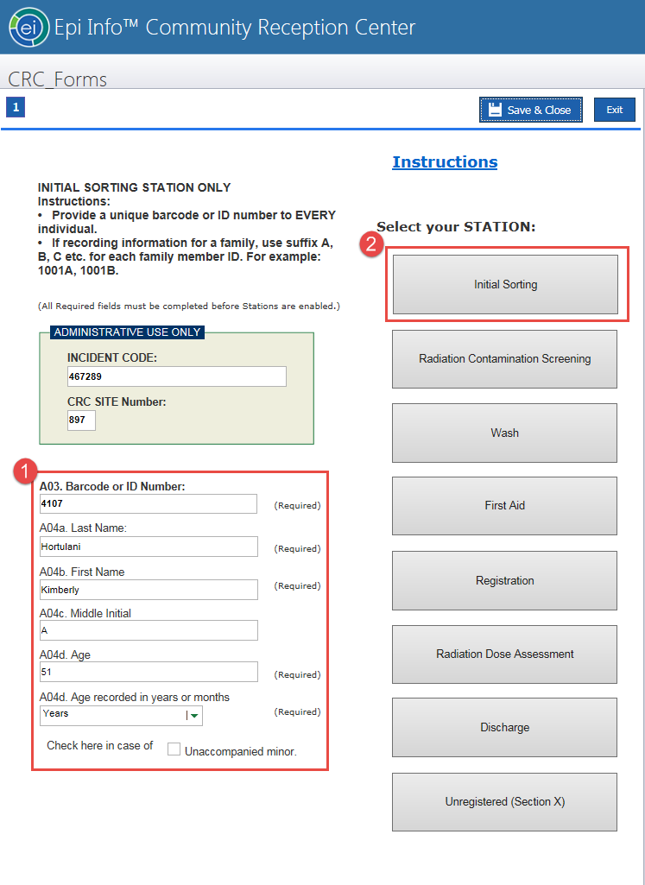
Initial Sorting Station
Entry point for all individuals
If recording information for a family , use suffix A, B, C etc. for each family member in “Barcode” or “ID Number” field
1001A, 1001B
Enter required fields (1)
Select “Initial Sorting” (2)
Notes:
Staff at Welcome Desk, which could be same as the Initial Sorting station, will click the “+Add New Record” button which will lead to the next screen shown here. This is entry point for all individuals.
First, provide a unique barcode or ID number for each individual. If the information is for a family, use suffix A, B, C etc. for each family member in “Barcode” or “ID Number” field. For example, 1001A for member 1, 1001B for member 2 and so on. Then collect information on all required fields: Last Name, First Name, Middle Initial (optional), and Age. For infants between 0 to 11 months of age, click “Months” when collecting age information.
Then click on “Initial Sorting” button to open the “Initial Sorting” form. Remember, ONLY the staff at Welcome Desk or Initial Sorting station should click this button as they enter information on NEW individuals coming to this CRC.

Slide 23
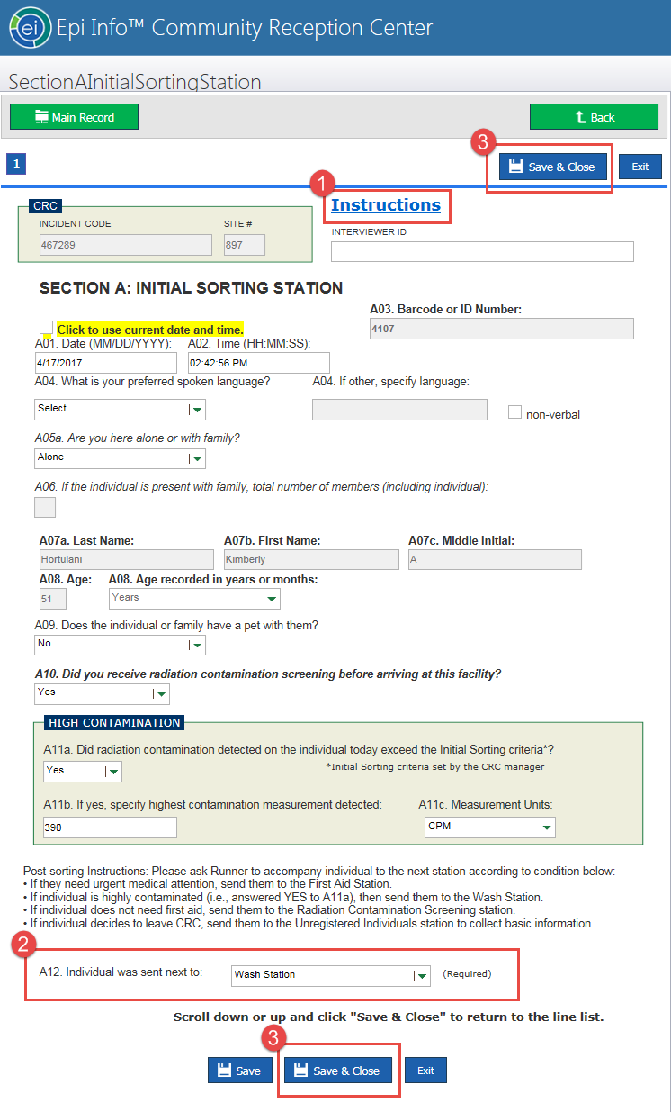
Initial Sorting Station
New record
Instructions at the top (1)
Complete all required fields (2)
Click “Save & Close” (3)
Decide next station based on exposure level and/or medical needs
Notes:
This is the “Initial Sorting Station” form, which is the entry point for all individuals receiving service at this CRC.
Click the button for “Instructions” at the top right of the screen to learn how to collect information at this station.
Remember to collect information on ALL required fields on this form.
2. Make sure you indicate where the person is going after initial sorting based on the information collected on this form. For example, a person with injuries will go to the first aid station; a person with high radioactive contamination will go to the “Wash” station.
3. After collecting all required information, click the “Save & Close” button, which is located at the top right and also at the bottom of this form.

Slide 24
All Stations
Line list
Notes:
Here is the Line List, from which you can select the individual record.
Remember, you can add new record ONLY at Initial Sorting.

Slide 25
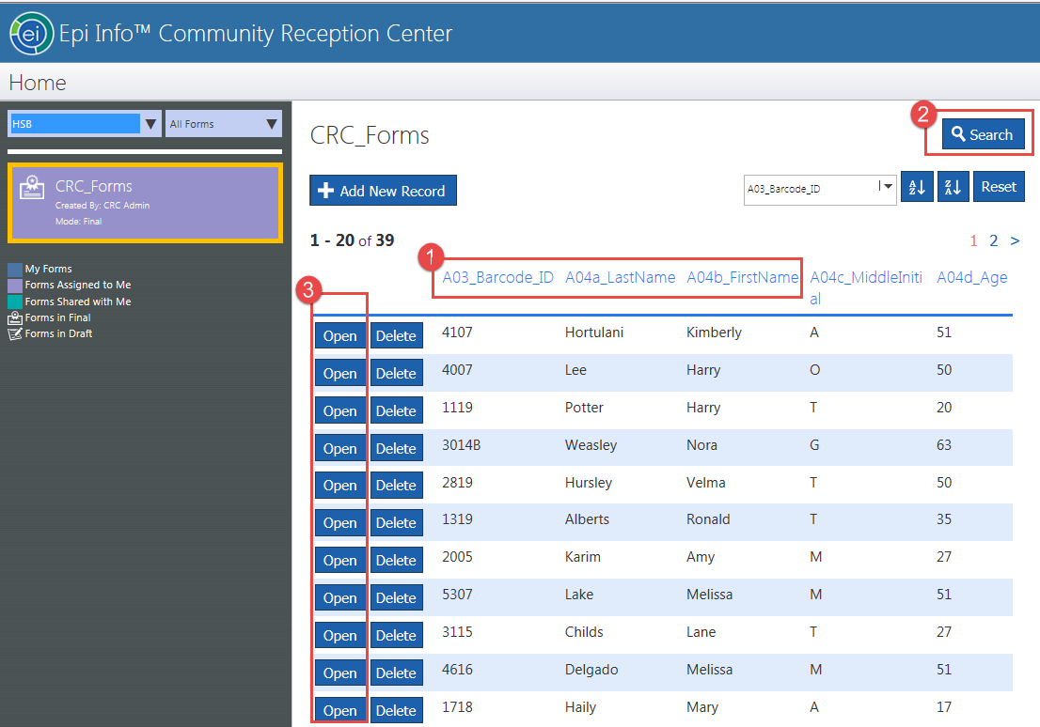
All Other Stations
Do NOT click on “Add New Record”
Visually search for “Barcode ID” or “Lastname” (1)
Optionally, use “Search” (2)
Click “Open” on the line list to select the individual (3)
Notes:
For all other stations, do NOT click on “Add New Record.”
1. To collect information for your respective station, you can find the individual from the line list. You can sort all fields shown here, for example, “Barcode ID” or “Lastname.”
2. You can also use “Search” to find the individual
3. Once you find the individual’s record, click “Open.”

Slide 26
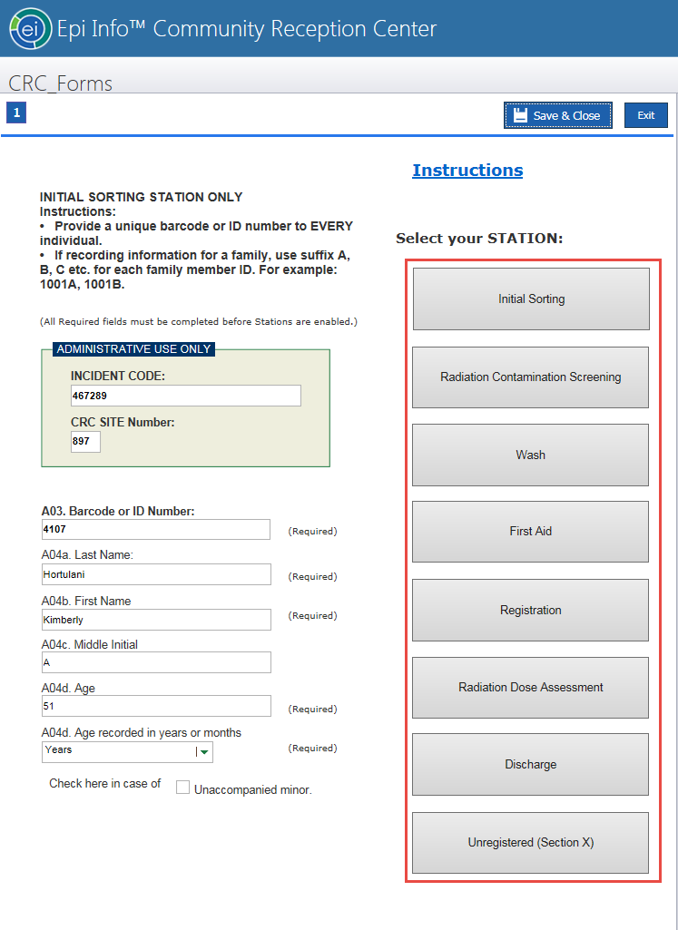
All Other Stations
For data entry, select the station assigned to you
Follow station-specific instructions provided
Notes:
Once the record of the individual is open, you will see the screen with the list of stations.
Select the station assigned to you to enter data.
For station-specific instructions, click the button at the top of each screen.

Slide 27
All Stations
Designed based on paper version
Built-in skip patterns
Include station-specific instructions

Slide 28
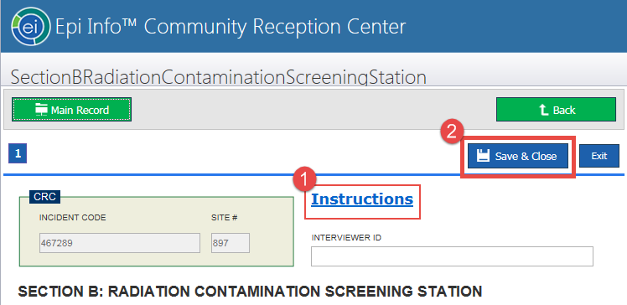
All Stations
Find instructions on the first page of each station form (1)
Read instructions before completing information
Collect information on all required fields
Follow built-in skip-patterns
Always click “Save & Close” (2)
Notes:
As mentioned earlier, the “Instructions” button is on top of each screen. Read the instructions before completing information collection.
At every station, collect information on all required fields.
Skip-patterns are built-in; they help simplify data collection.
After collecting information, click “Save & Close” button. Always save information!

Slide 29
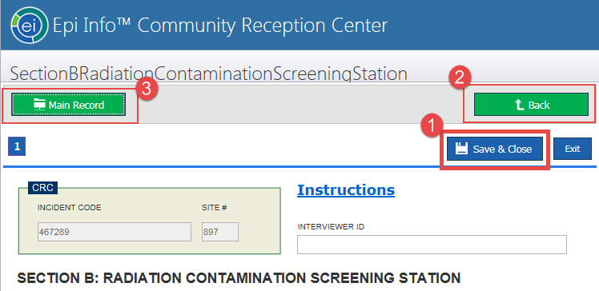
All Stations
Always click “Save & Close” (1)
“Back” returns to the page with station buttons (2)
“Main Record” returns to the page with station buttons (3)
Notes:
Can’t stress this enough, always “Save & Close”
The “Back” button will take you back to the screen with all station buttons
CLICK NEXT

Slide 30
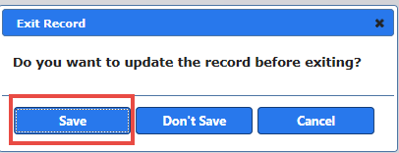
All Stations
Do not click “Exit”
If you accidentally clicked “Exit,” make sure you click “Save” in the pop-up if you have changed or added any information
Notes:
One more thing to keep in mind: Do Not Click EXIT!
If you clicked Exit accidently, make sure you click “Save” in the pop-up box to save information. Otherwise it will lose all information collected for the record.

Slide 31
For more info …
Questions?

